Slide 1
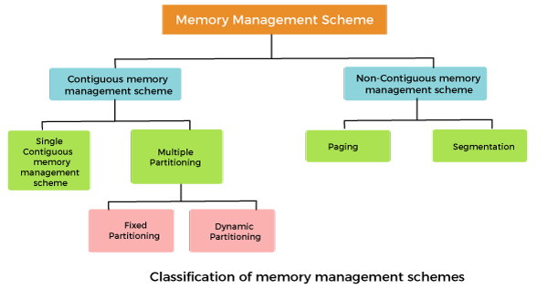
CS3451 - INTRODUCTION TO OPERATING SYSTEMS
Dr. MAHAVISHNU.V.C

Slide 2

Syllabus
UNIT III MEMORY MANAGEMENT 10
Main Memory - Swapping - Contiguous Memory Allocation – Paging - Structure of the Page Table - Segmentation, Segmentation with paging; Virtual Memory - Demand Paging – Copy on Write - Page Replacement - Allocation of Frames –Thrashing.
Slide courtesy of

Slide 3
Background
Program must be brought (from disk) into memory and placed within a process for it to be run
Main memory and registers are only storage CPU can access directly
Memory unit only sees a stream of:
addresses + read requests, or
address + data and write requests
Register access is done in one CPU clock (or less)
Main memory can take many cycles, causing a stall
Cache sits between main memory and CPU registers
Protection of memory required to ensure correct operation

Slide 4

Protection
Need to ensure that a process can access only those addresses in its address space.
We can provide this protection by using a pair of base and limit registers define the logical address space of a process

Slide 5
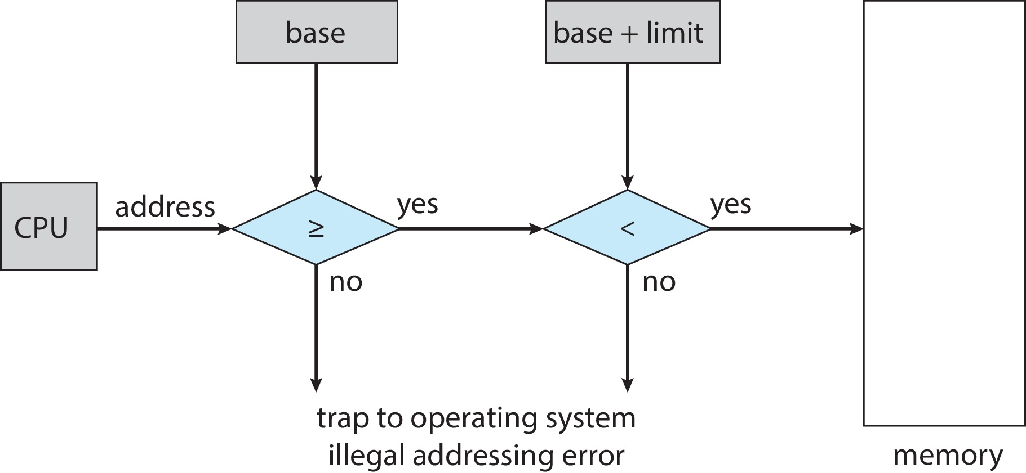
Hardware Address Protection
CPU must check every memory access generated in user mode to be sure it is between base and limit for that user
the instructions to loading the base and limit registers are privileged

Slide 6
Address Binding
Programs on disk, ready to be brought into memory to execute form an input queue
Without support, must be loaded into address 0000
Inconvenient to have first user process physical address always at 0000
How can it not be?
Addresses represented in different ways at different stages of a program’s life
Source code addresses usually symbolic
Compiled code addresses bind to relocatable addresses
i.e., “14 bytes from beginning of this module”
Linker or loader will bind relocatable addresses to absolute addresses
i.e., 74014
Each binding maps one address space to another

Slide 7
Binding of Instructions and Data to Memory
Address binding of instructions and data to memory addresses can happen at three different stages
Compile time: If memory location known a priori, absolute code can be generated; must recompile code if starting location changes
Load time: Must generate relocatable code if memory location is not known at compile time
Execution time: Binding delayed until run time if the process can be moved during its execution from one memory segment to another
Need hardware support for address maps (e.g., base and limit registers)

Slide 8

Multistep Processing of a User Program

Slide 9
Logical vs. Physical Address Space
The concept of a logical address space that is bound to a separate physical address space is central to proper memory management
Logical address – generated by the CPU; also referred to as virtual address
Physical address – address seen by the memory unit
Logical and physical addresses are the same in compile-time and load-time address-binding schemes; logical (virtual) and physical addresses differ in execution-time address-binding scheme
Logical address space is the set of all logical addresses generated by a program
Physical address space is the set of all physical addresses generated by a program

Slide 10
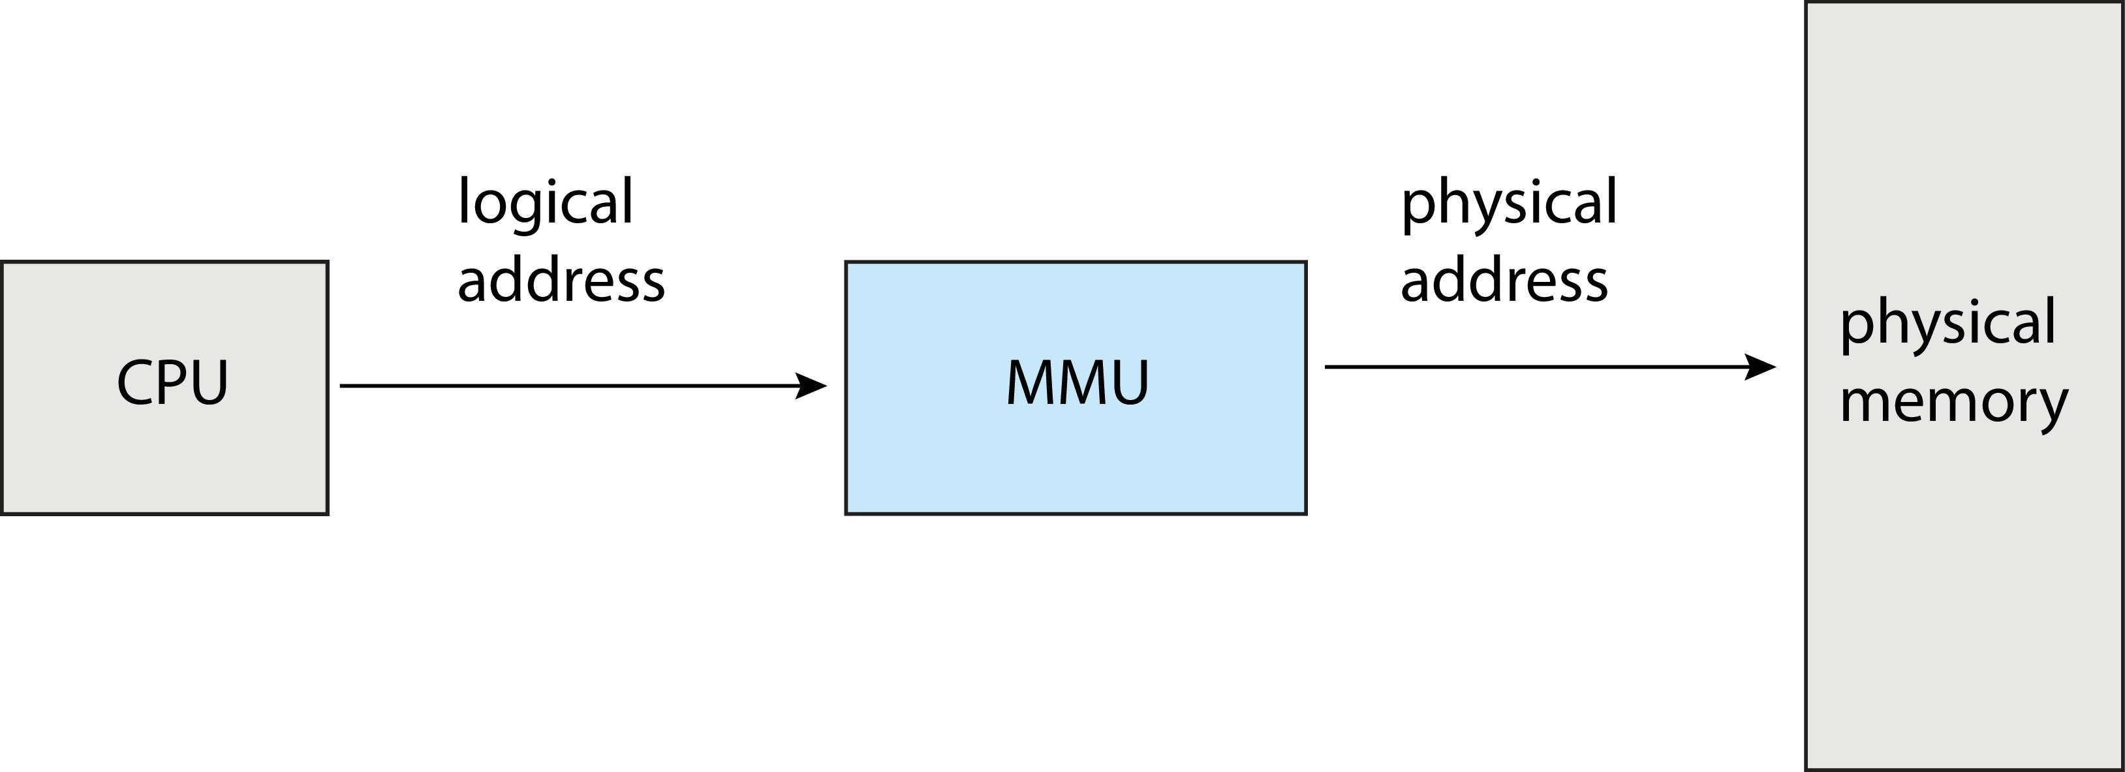
Memory-Management Unit (MMU)
Hardware device that at run time maps virtual to physical address

Slide 11
Memory-Management Unit (Cont.)
Consider simple scheme. which is a generalization of the base-register scheme.
The base register now called relocation register
The value in the relocation register is added to every address generated by a user process at the time it is sent to memory
The user program deals with logical addresses; it never sees the real physical addresses
Execution-time binding occurs when reference is made to location in memory
Logical address bound to physical addresses

Slide 12
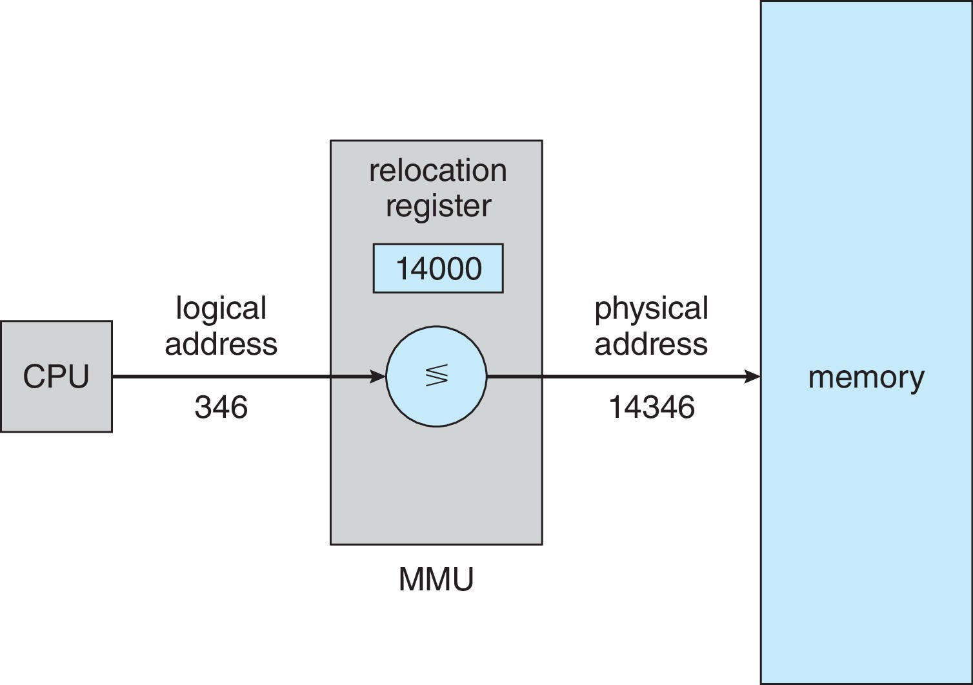
Memory-Management Unit (Cont.)
Consider simple scheme. which is a generalization of the base-register scheme.
The base register now called relocation register
The value in the relocation register is added to every address generated by a user process at the time it is sent to memory

Slide 13
Dynamic Loading
The entire program does need to be in memory to execute
Routine is not loaded until it is called
Better memory-space utilization; unused routine is never loaded
All routines kept on disk in relocatable load format
Useful when large amounts of code are needed to handle infrequently occurring cases
No special support from the operating system is required
Implemented through program design
OS can help by providing libraries to implement dynamic loading

Slide 14
Dynamic Linking
Static linking – system libraries and program code combined by the loader into the binary program image
Dynamic linking –linking postponed until execution time
Small piece of code, stub, used to locate the appropriate memory-resident library routine
Stub replaces itself with the address of the routine, and executes the routine
Operating system checks if routine is in processes’ memory address
If not in address space, add to address space
Dynamic linking is particularly useful for libraries
System also known as shared libraries
Consider applicability to patching system libraries
Versioning may be needed

Slide 15
Contiguous Allocation
Main memory must support both OS and user processes
Limited resource, must allocate efficiently
Contiguous allocation is one early method
Main memory usually into two partitions:
Resident operating system, usually held in low memory with interrupt vector
User processes then held in high memory
Each process contained in single contiguous section of memory

Slide 16
Contiguous Allocation (Cont.)
Relocation registers used to protect user processes from each other, and from changing operating-system code and data
Base register contains value of smallest physical address
Limit register contains range of logical addresses – each logical address must be less than the limit register
MMU maps logical address dynamically
Can then allow actions such as kernel code being transient and kernel changing size

Slide 17

Hardware Support for Relocation and Limit Registers

Slide 18
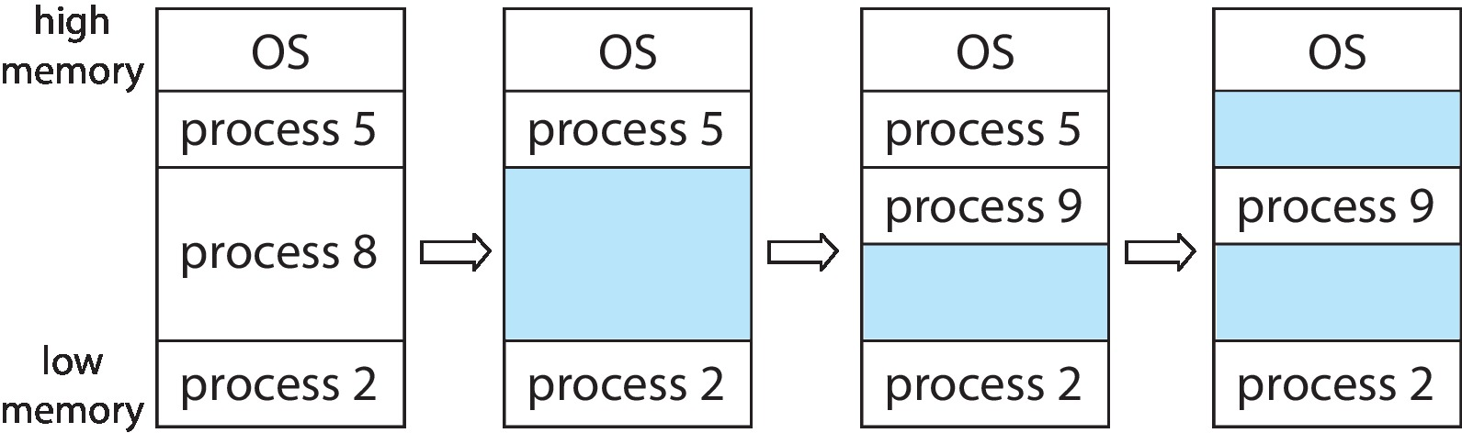
Variable Partition
Multiple-partition allocation
Degree of multiprogramming limited by number of partitions
Variable-partition sizes for efficiency (sized to a given process’ needs)
Hole – block of available memory; holes of various size are scattered throughout memory
When a process arrives, it is allocated memory from a hole large enough to accommodate it
Process exiting frees its partition, adjacent free partitions combined
Operating system maintains information about: a) allocated partitions b) free partitions (hole)

Slide 19
Dynamic Storage-Allocation Problem
How to satisfy a request of size n from a list of free holes?
First-fit: Allocate the first hole that is big enough
Best-fit: Allocate the smallest hole that is big enough; must search entire list, unless ordered by size
Produces the smallest leftover hole
Worst-fit: Allocate the largest hole; must also search entire list
Produces the largest leftover hole
First-fit and best-fit better than worst-fit in terms of speed and storage utilization

Slide 20
Fragmentation
External Fragmentation – total memory space exists to satisfy a request, but it is not contiguous
Internal Fragmentation – allocated memory may be slightly larger than requested memory; this size difference is memory internal to a partition, but not being used
First fit analysis reveals that given N blocks allocated, 0.5 N blocks lost to fragmentation
1/3 may be unusable -> 50-percent rule

Slide 21
Fragmentation (Cont.)
Reduce external fragmentation by compaction
Shuffle memory contents to place all free memory together in one large block
Compaction is possible only if relocation is dynamic, and is done at execution time
I/O problem
Latch job in memory while it is involved in I/O
Do I/O only into OS buffers
Now consider that backing store has same fragmentation problems

Slide 22
Paging
Physical address space of a process can be noncontiguous; process is allocated physical memory whenever the latter is available
Avoids external fragmentation
Avoids problem of varying sized memory chunks
Divide physical memory into fixed-sized blocks called frames
Size is power of 2, between 512 bytes and 16 Mbytes
Divide logical memory into blocks of same size called pages
Keep track of all free frames
To run a program of size N pages, need to find N free frames and load program
Set up a page table to translate logical to physical addresses
Backing store likewise split into pages
Still have Internal fragmentation

Slide 23
Address Translation Scheme
Address generated by CPU is divided into:
Page number (p) – used as an index into a page table which contains base address of each page in physical memory
Page offset (d) – combined with base address to define the physical memory address that is sent to the memory unit
For given logical address space 2^{m} and page size 2^{n}

Slide 24

Paging Hardware

Slide 25

Paging Model of Logical and Physical Memory

Slide 26

Paging Example
Logical address: n = 2 and m = 4. Using a page size of 4 bytes and a physical memory of 32 bytes (8 pages)

Slide 27
Paging -- Calculating internal fragmentation
Page size = 2,048 bytes
Process size = 72,766 bytes
35 pages + 1,086 bytes
Internal fragmentation of 2,048 - 1,086 = 962 bytes
Worst case fragmentation = 1 frame – 1 byte
On average fragmentation = 1 / 2 frame size
So small frame sizes desirable?
But each page table entry takes memory to track
Page sizes growing over time
Solaris supports two page sizes – 8 KB and 4 MB

Slide 28

Free Frames
Before allocation
After allocation

Slide 29
Implementation of Page Table
Page table is kept in main memory
Page-table base register (PTBR) points to the page table
Page-table length register (PTLR) indicates size of the page table
In this scheme every data/instruction access requires two memory accesses
One for the page table and one for the data / instruction
The two-memory access problem can be solved by the use of a special fast-lookup hardware cache called translation look-aside buffers (TLBs) (also called associative memory).

Slide 30
Translation Look-Aside Buffer
Some TLBs store address-space identifiers (ASIDs) in each TLB entry – uniquely identifies each process to provide address-space protection for that process
Otherwise need to flush at every context switch
TLBs typically small (64 to 1,024 entries)
On a TLB miss, value is loaded into the TLB for faster access next time
Replacement policies must be considered
Some entries can be wired down for permanent fast access

Slide 31
Hardware
Associative memory – parallel search
Address translation (p, d)
If p is in associative register, get frame # out
Otherwise get frame # from page table in memory

Slide 32

Paging Hardware With TLB

Slide 33
Effective Access Time
Hit ratio – percentage of times that a page number is found in the TLB
An 80% hit ratio means that we find the desired page number in the TLB 80% of the time.
Suppose that 10 nanoseconds to access memory.
If we find the desired page in TLB then a mapped-memory access take 10 ns
Otherwise we need two memory access so it is 20 ns
Effective Access Time (EAT)
EAT = 0.80 x 10 + 0.20 x 20 = 12 nanoseconds
implying 20% slowdown in access time
Consider amore realistic hit ratio of 99%,
EAT = 0.99 x 10 + 0.01 x 20 = 10.1ns
implying only 1% slowdown in access time.

Slide 34
Memory Protection
Memory protection implemented by associating protection bit with each frame to indicate if read-only or read-write access is allowed
Can also add more bits to indicate page execute-only, and so on
Valid-invalid bit attached to each entry in the page table:
“valid” indicates that the associated page is in the process’ logical address space, and is thus a legal page
“invalid” indicates that the page is not in the process’ logical address space
Or use page-table length register (PTLR)
Any violations result in a trap to the kernel

Slide 35

Valid (v) or Invalid (i) Bit In A Page Table

Slide 36
Shared Pages
Shared code
One copy of read-only (reentrant) code shared among processes (i.e., text editors, compilers, window systems)
Similar to multiple threads sharing the same process space
Also useful for interprocess communication if sharing of read-write pages is allowed
Private code and data
Each process keeps a separate copy of the code and data
The pages for the private code and data can appear anywhere in the logical address space

Slide 37

Shared Pages Example

Slide 38
Structure of the Page Table
Memory structures for paging can get huge using straight-forward methods
Consider a 32-bit logical address space as on modern computers
Page size of 4 KB (2¹²)
Page table would have 1 million entries (2³² / 2¹²)
If each entry is 4 bytes ➔ each process 4 MB of physical address space for the page table alone
Don’t want to allocate that contiguously in main memory
One simple solution is to divide the page table into smaller units
Hierarchical Paging
Hashed Page Tables
Inverted Page Tables

Slide 39

Hierarchical Page Tables
Break up the logical address space into multiple page tables
A simple technique is a two-level page table
We then page the page table

Slide 40
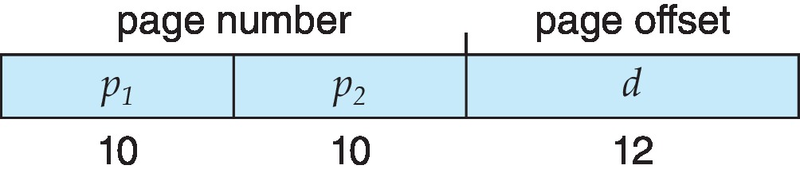
Two-Level Paging Example
A logical address (on 32-bit machine with 4K page size) is divided into:
a page number consisting of 20 bits
a page offset consisting of 12 bits
Since the page table is paged, the page number is further divided into:
a 10-bit page number
a 10-bit page offset
Thus, a logical address is as follows:
where p₁ is an index into the outer page table, and p₂ is the displacement within the page of the inner page table
Known as forward-mapped page table

Slide 41

Address-Translation Scheme

Slide 42
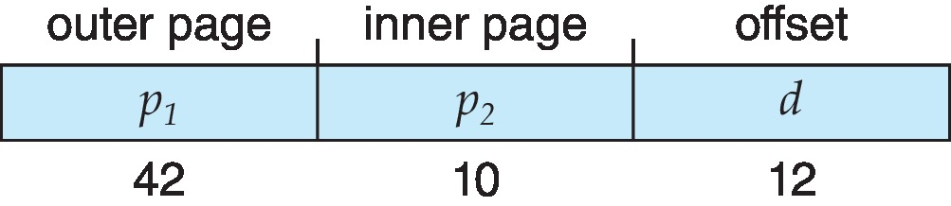
64-bit Logical Address Space
Even two-level paging scheme not sufficient
If page size is 4 KB (2¹²)
Then page table has 2⁵² entries
If two level scheme, inner page tables could be 2¹⁰ 4-byte entries
Address would look like
Outer page table has 2⁴² entries or 2⁴⁴ bytes
One solution is to add a 2nd outer page table
But in the following example the 2nd outer page table is still 2³⁴ bytes in size
And possibly 4 memory access to get to one physical memory location

Slide 43


Three-level Paging Scheme

Slide 44
Hashed Page Tables
Common in address spaces > 32 bits
The virtual page number is hashed into a page table
This page table contains a chain of elements hashing to the same location
Each element contains (1) the virtual page number (2) the value of the mapped page frame (3) a pointer to the next element
Virtual page numbers are compared in this chain searching for a match
If a match is found, the corresponding physical frame is extracted
Variation for 64-bit addresses is clustered page tables
Similar to hashed but each entry refers to several pages (such as 16) rather than 1
Especially useful for sparse address spaces (where memory references are non-contiguous and scattered)

Slide 45

Hashed Page Table

Slide 46
Inverted Page Table
Rather than each process having a page table and keeping track of all possible logical pages, track all physical pages
One entry for each real page of memory
Entry consists of the virtual address of the page stored in that real memory location, with information about the process that owns that page
Decreases memory needed to store each page table, but increases time needed to search the table when a page reference occurs
Use hash table to limit the search to one — or at most a few — page-table entries
TLB can accelerate access
But how to implement shared memory?
One mapping of a virtual address to the shared physical address

Slide 47

Inverted Page Table Architecture

Slide 48
Oracle SPARC Solaris
Consider modern, 64-bit operating system example with tightly integrated HW
Goals are efficiency, low overhead
Based on hashing, but more complex
Two hash tables
One kernel and one for all user processes
Each maps memory addresses from virtual to physical memory
Each entry represents a contiguous area of mapped virtual memory,
More efficient than having a separate hash-table entry for each page
Each entry has base address and span (indicating the number of pages the entry represents)

Slide 49
Oracle SPARC Solaris (Cont.)
TLB holds translation table entries (TTEs) for fast hardware lookups
A cache of TTEs reside in a translation storage buffer (TSB)
Includes an entry per recently accessed page
Virtual address reference causes TLB search
If miss, hardware walks the in-memory TSB looking for the TTE corresponding to the address
If match found, the CPU copies the TSB entry into the TLB and translation completes
If no match found, kernel interrupted to search the hash table
The kernel then creates a TTE from the appropriate hash table and stores it in the TSB, Interrupt handler returns control to the MMU, which completes the address translation.

Slide 50
Swapping
A process can be swapped temporarily out of memory to a backing store, and then brought back into memory for continued execution
Total physical memory space of processes can exceed physical memory
Backing store – fast disk large enough to accommodate copies of all memory images for all users; must provide direct access to these memory images
Roll out, roll in – swapping variant used for priority-based scheduling algorithms; lower-priority process is swapped out so higher-priority process can be loaded and executed
Major part of swap time is transfer time; total transfer time is directly proportional to the amount of memory swapped
System maintains a ready queue of ready-to-run processes which have memory images on disk

Slide 51
Swapping (Cont.)
Does the swapped out process need to swap back in to same physical addresses?
Depends on address binding method
Plus consider pending I/O to / from process memory space
Modified versions of swapping are found on many systems (i.e., UNIX, Linux, and Windows)
Swapping normally disabled
Started if more than threshold amount of memory allocated
Disabled again once memory demand reduced below threshold

Slide 52

Schematic View of Swapping

Slide 53
Context Switch Time including Swapping
If next processes to be put on CPU is not in memory, need to swap out a process and swap in target process
Context switch time can then be very high
100MB process swapping to hard disk with transfer rate of 50MB/sec
Swap out time of 2000 ms
Plus swap in of same sized process
Total context switch swapping component time of 4000ms (4 seconds)
Can reduce if reduce size of memory swapped – by knowing how much memory really being used
System calls to inform OS of memory use via request_memory() and release_memory()

Slide 54
Context Switch Time and Swapping (Cont.)
Other constraints as well on swapping
Pending I/O – can’t swap out as I/O would occur to wrong process
Or always transfer I/O to kernel space, then to I/O device
Known as double buffering, adds overhead
Standard swapping not used in modern operating systems
But modified version common
Swap only when free memory extremely low

Slide 55
Swapping on Mobile Systems
Not typically supported
Flash memory based
Small amount of space
Limited number of write cycles
Poor throughput between flash memory and CPU on mobile platform
Instead use other methods to free memory if low
iOS asks apps to voluntarily relinquish allocated memory
Read-only data thrown out and reloaded from flash if needed
Failure to free can result in termination
Android terminates apps if low free memory, but first writes application state to flash for fast restart
Both OSes support paging as discussed below

Slide 56
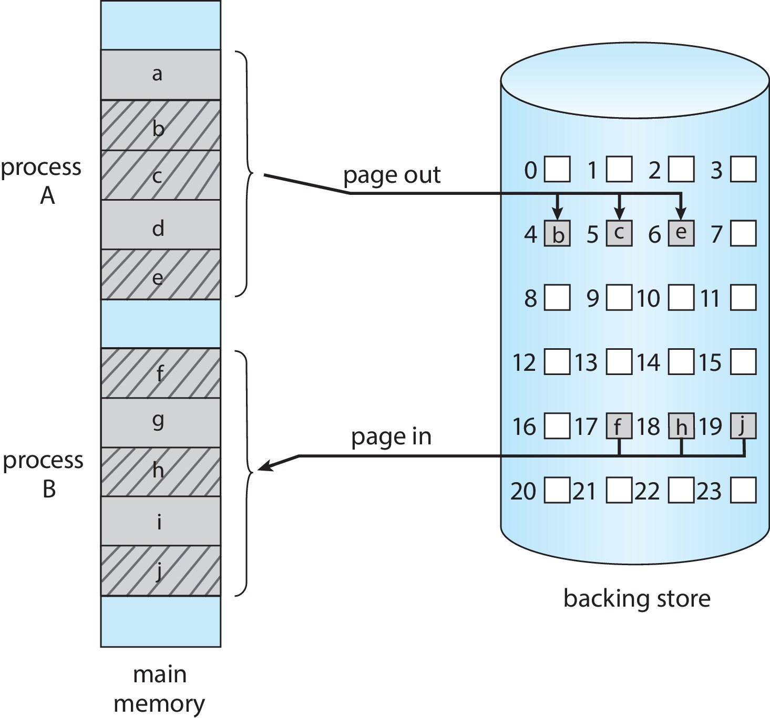
Swapping with Paging

Slide 57
Segmentation
A process is divided into Segments.
The chunks that a program is divided into which are not necessarily all of the exact sizes are called segments.
Segmentation gives the user’s view of the process which paging does not provide. Here the user’s view is mapped to physical memory.

Slide 58
Segmentation
Virtual Memory Segmentation: Each process is divided into a number of segments, but the segmentation is not done all at once. This segmentation may or may not take place at the run time of the program.
Simple Segmentation: Each process is divided into a number of segments, all of which are loaded into memory at run time, though not necessarily contiguously.
There is no simple relationship between logical addresses and physical addresses in segmentation. A table stores the information about all such segments and is called Segment Table.

Slide 59
Segment Table
What is Segment Table?
It maps a two-dimensional Logical address into a one-dimensional Physical address.
It’s each table entry has:
Base Address: It contains the starting physical address where the segments reside in memory.
Segment Limit: Also known as segment offset. It specifies the length of the segment.

Slide 60
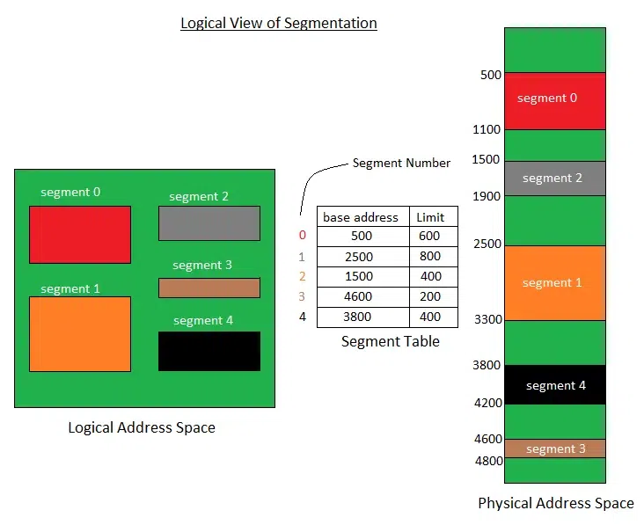
Segment Table

Slide 61
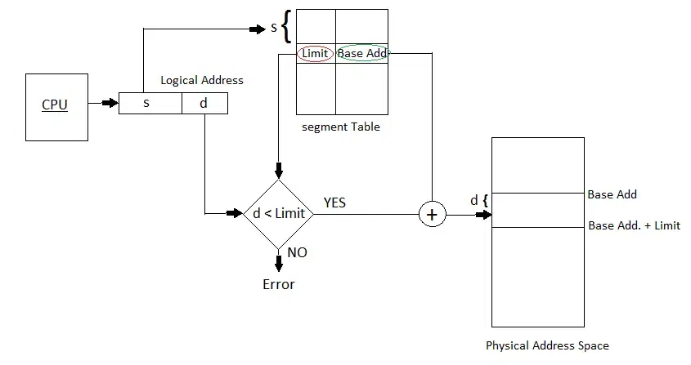
Segment Table
The address generated by the CPU is divided into:
Segment number (s): Number of bits required to represent the segment.
Segment offset (d): Number of bits required to represent the position of data within a segment.

Slide 62
Advantages of Segmentation in Operating System
Reduced Internal Fragmentation
Flexibility
Sharing
Protection

Slide 63
Example: The Intel 32 and 64-bit Architectures
Dominant industry chips
Pentium CPUs are 32-bit and called IA-32 architecture
Current Intel CPUs are 64-bit and called IA-64 architecture
Many variations in the chips, cover the main ideas here

Slide 64
Example: The Intel IA-32 Architecture
Supports both segmentation and segmentation with paging
Each segment can be 4 GB
Up to 16 K segments per process
Divided into two partitions
First partition of up to 8 K segments are private to process (kept in local descriptor table (LDT))
Second partition of up to 8K segments shared among all processes (kept in global descriptor table (GDT))

Slide 65

Example: The Intel IA-32 Architecture (Cont.)
CPU generates logical address
Selector given to segmentation unit
Which produces linear addresses
Linear address given to paging unit
Which generates physical address in main memory
Paging units form equivalent of MMU
Pages sizes can be 4 KB or 4 MB

Slide 66
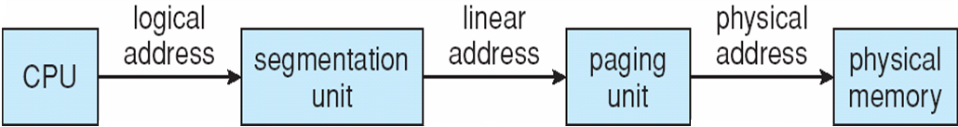
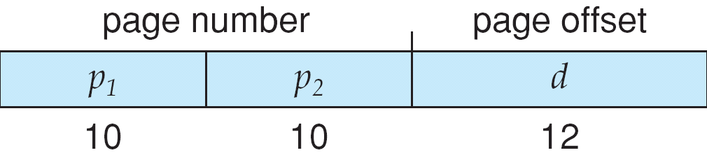
Logical to Physical Address Translation in IA-32

Slide 67
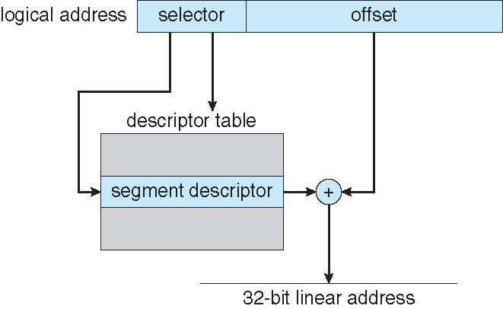
Intel IA-32 Segmentation

Slide 68
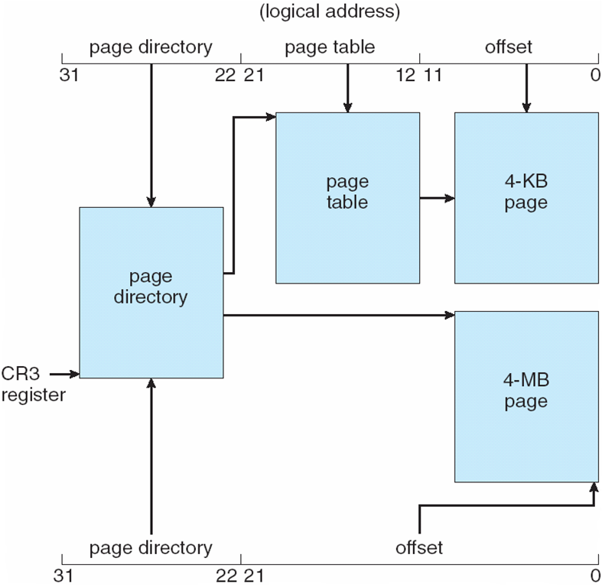
Intel IA-32 Paging Architecture

Slide 69
Intel IA-32 Page Address Extensions
32-bit address limits led Intel to create page address extension (PAE), allowing 32-bit apps access to more than 4GB of memory space
Paging went to a 3-level scheme
Top two bits refer to a page directory pointer table
Page-directory and page-table entries moved to 64-bits in size
Net effect is increasing address space to 36 bits – 64GB of physical memory

Slide 70
Intel x86-64
Current generation Intel x86 architecture
64 bits is ginormous (> 16 exabytes)
In practice only implement 48 bit addressing
Page sizes of 4 KB, 2 MB, 1 GB
Four levels of paging hierarchy
Can also use PAE so virtual addresses are 48 bits and physical addresses are 52 bits

Slide 71
Example: ARM Architecture
Dominant mobile platform chip (Apple iOS and Google Android devices for example)
Modern, energy efficient, 32-bit CPU
4 KB and 16 KB pages
1 MB and 16 MB pages (termed sections)
One-level paging for sections, two-level for smaller pages
Two levels of TLBs
Outer level has two micro TLBs (one data, one instruction)
Inner is single main TLB
First inner is checked, on miss outers are checked, and on miss page table walk performed by CPU

Slide 72
Virtual memory
Virtual memory – separation of user logical memory from physical memory
Only part of the program needs to be in memory for execution
Logical address space can therefore be much larger than physical address space
Allows address spaces to be shared by several processes
Allows for more efficient process creation
More programs running concurrently
Less I/O needed to load or swap processes

Slide 73
Virtual memory (Cont.)
Virtual address space – logical view of how process is stored in memory
Usually start at address 0, contiguous addresses until end of space
Meanwhile, physical memory organized in page frames
MMU must map logical to physical
Virtual memory can be implemented via:
Demand paging
Demand segmentation

Slide 74
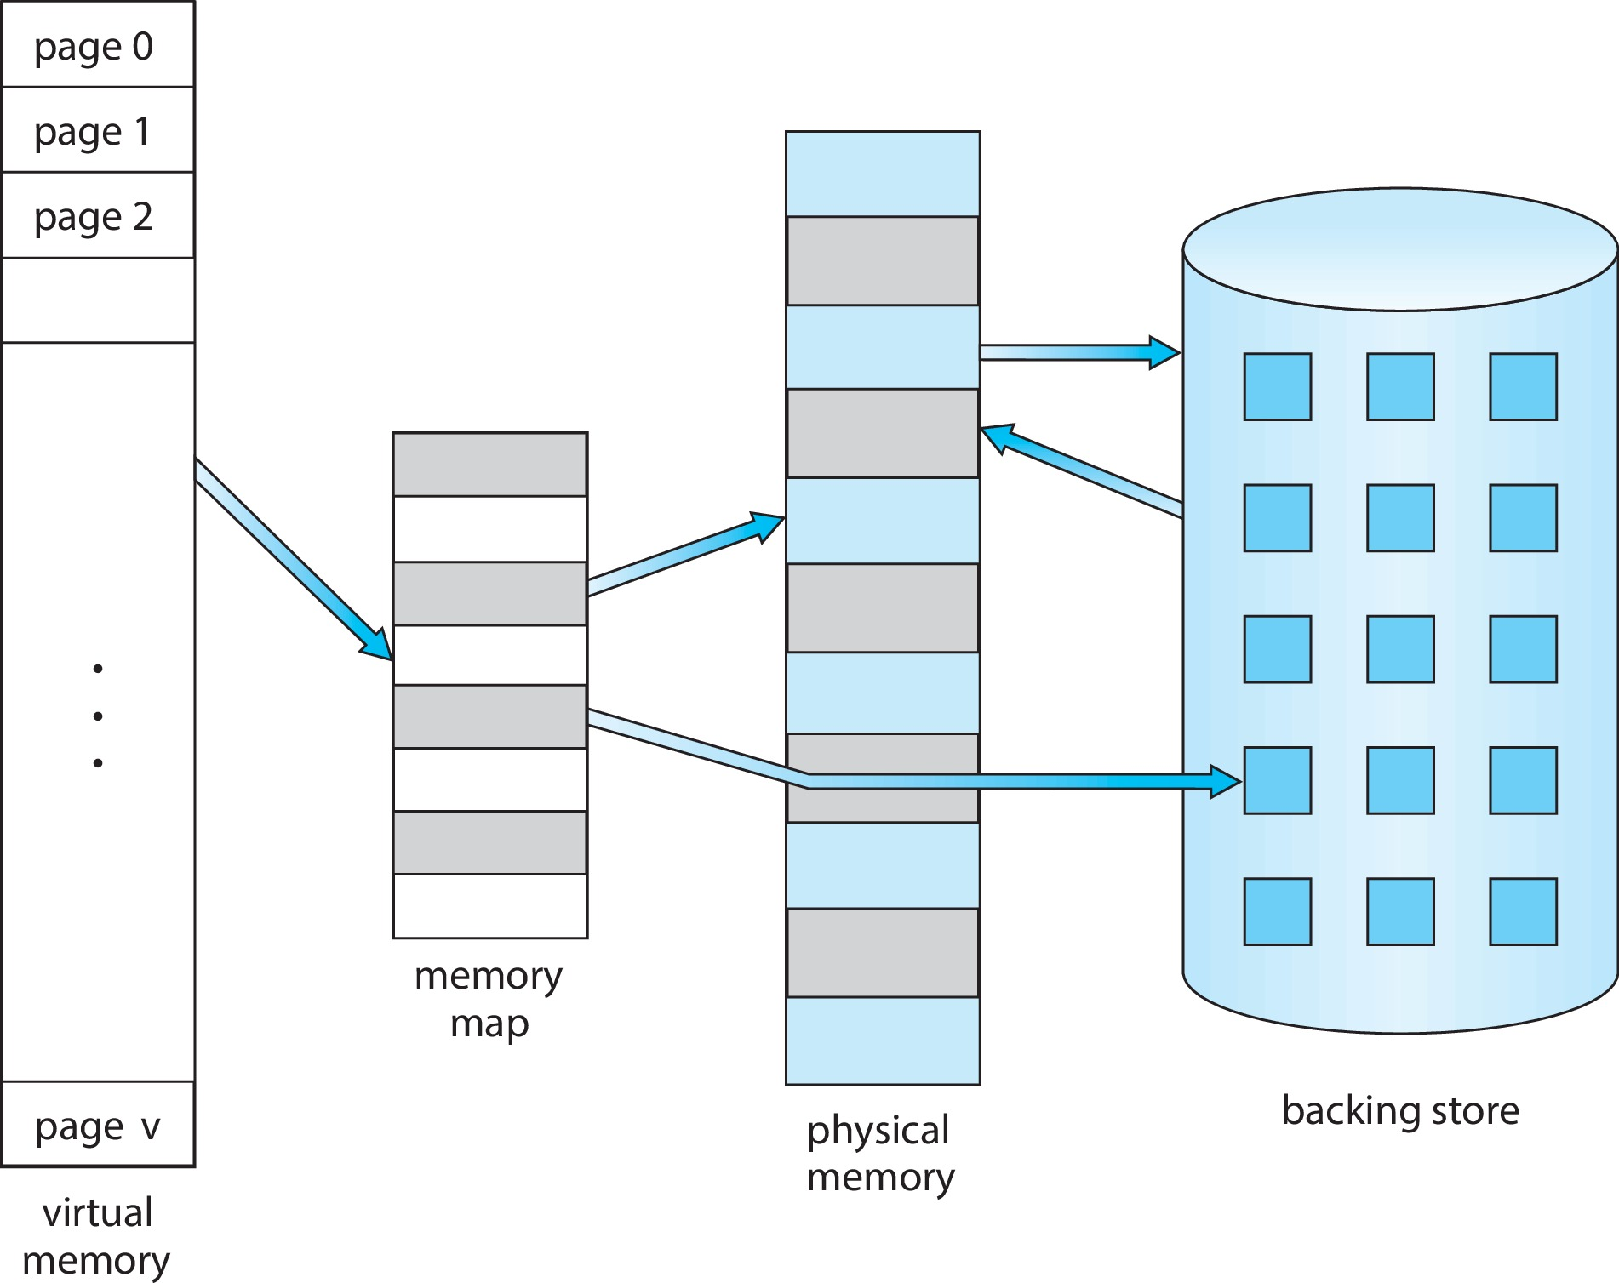
Virtual Memory That is Larger Than Physical Memory

Slide 75

Virtual-address Space
Usually design logical address space for stack to start at Max logical address and grow “down” while heap grows “up”
Maximizes address space use
Unused address space between the two is hole
No physical memory needed until heap or stack grows to a given new page
Enables sparse address spaces with holes left for growth, dynamically linked libraries, etc.
System libraries shared via mapping into virtual address space
Shared memory by mapping pages read-write into virtual address space
Pages can be shared during fork(), speeding process creation

Slide 76
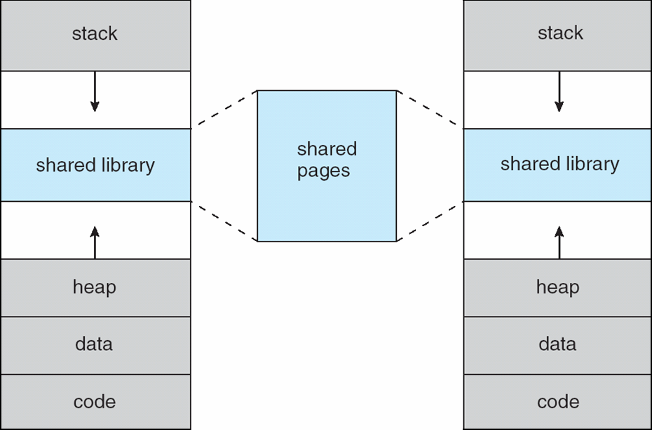
Shared Library Using Virtual Memory

Slide 77

Demand Paging
Could bring entire process into memory at load time
Or bring a page into memory only when it is needed
Less I/O needed, no unnecessary I/O
Less memory needed
Faster response
More users
Similar to paging system with swapping
Page is needed ⇒ reference to it
invalid reference ⇒ abort
not-in-memory ⇒ bring to memory
Lazy swapper – never swaps a page into memory unless page will be needed
Swapper that deals with pages is a pager

Slide 78
Demand Paging
Could bring entire process into memory at load time
Or bring a page into memory only when it is needed
Less I/O needed, no unnecessary I/O
Less memory needed
Faster response
More users
Similar to paging system with swapping (diagram on right)

Slide 79
Basic Concepts
With swapping, pager guesses which pages will be used before swapping out again
Instead, pager brings in only those pages into memory
How to determine that set of pages?
Need new MMU functionality to implement demand paging
If pages needed are already memory resident
No difference from non demand-paging
If page needed and not memory resident
Need to detect and load the page into memory from storage
Without changing program behavior
Without programmer needing to change code

Slide 80
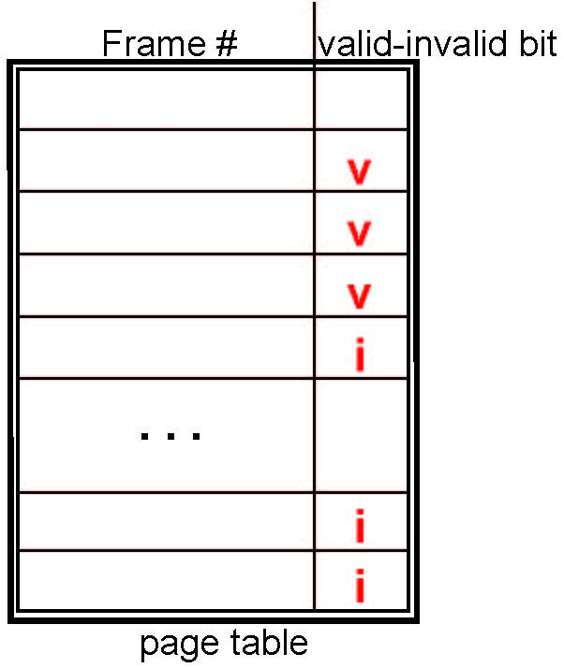
Valid-Invalid Bit
With each page table entry a valid–invalid bit is associated (v ⇒ in-memory – memory resident, i ⇒ not-in-memory)
Initially valid–invalid bit is set to i on all entries
Example of a page table snapshot:
During MMU address translation, if valid–invalid bit in page table entry is i ⇒ page fault

Slide 81
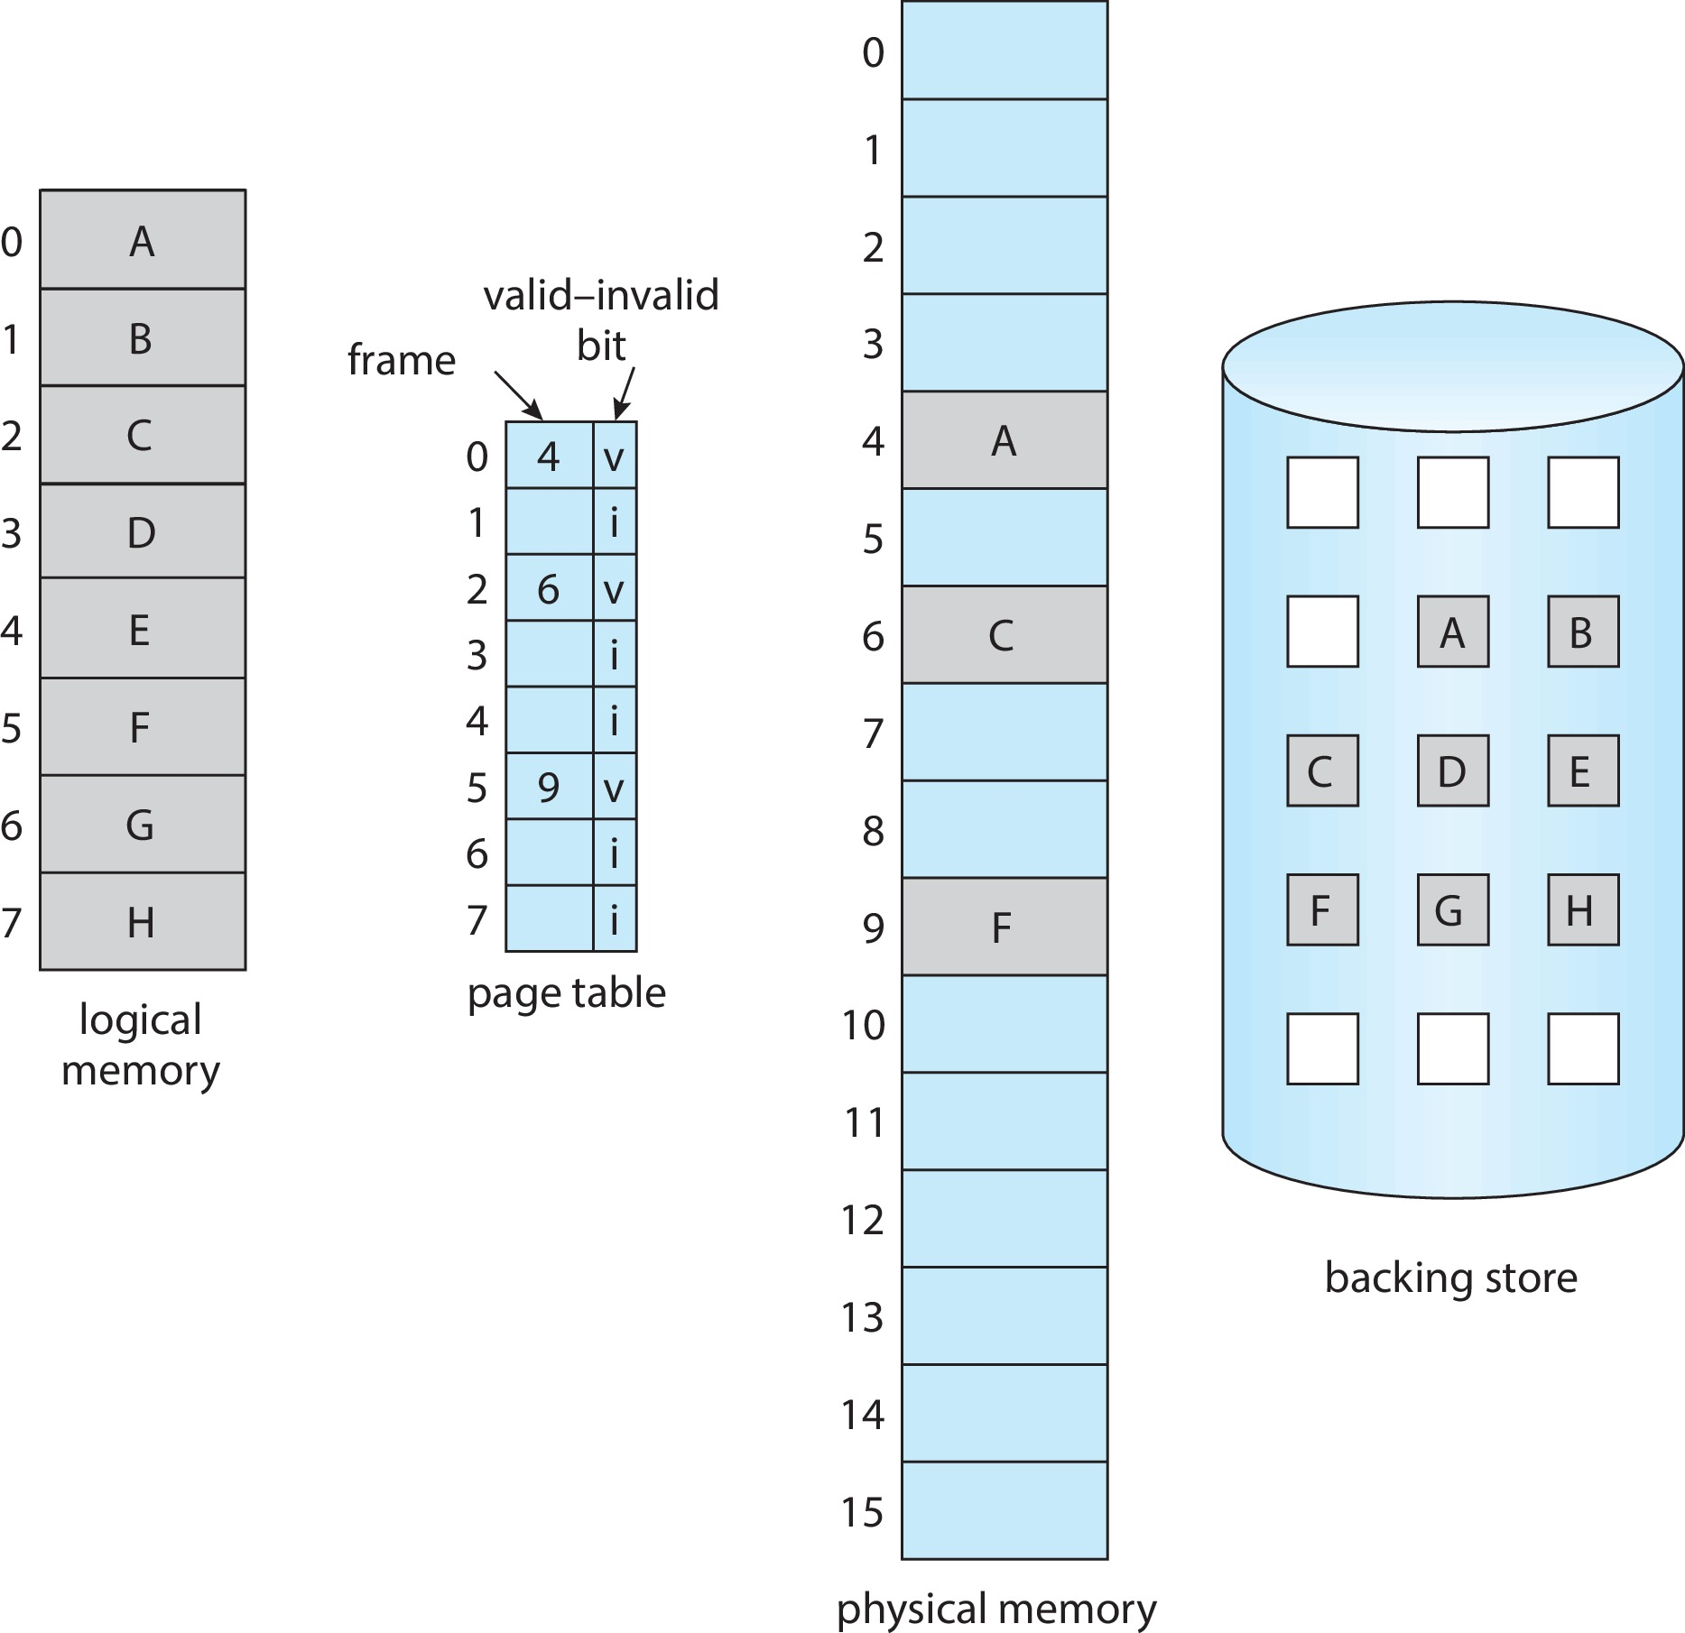
Page Table When Some Pages Are Not in Main Memory

Slide 82
Steps in Handling Page Fault
If there is a reference to a page, first reference to that page will trap to operating system
Page fault
Operating system looks at another table to decide:
Invalid reference ⇒ abort
Just not in memory
Find free frame
Swap page into frame via scheduled disk operation
Reset tables to indicate page now in memory Set validation bit = v
Restart the instruction that caused the page fault

Slide 83

Steps in Handling a Page Fault (Cont.)

Slide 84
Aspects of Demand Paging
Extreme case – start process with no pages in memory
OS sets instruction pointer to first instruction of process, non-memory-resident -> page fault
And for every other process pages on first access
Pure demand paging
Actually, a given instruction could access multiple pages -> multiple page faults
Consider fetch and decode of instruction which adds 2 numbers from memory and stores result back to memory
Pain decreased because of locality of reference
Hardware support needed for demand paging
Page table with valid / invalid bit
Secondary memory (swap device with swap space)
Instruction restart

Slide 85
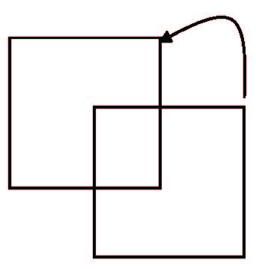
Instruction Restart
Consider an instruction that could access several different locations
Block move
Auto increment/decrement location
Restart the whole operation?
What if source and destination overlap?

Slide 86
Free-Frame List
When a page fault occurs, the operating system must bring the desired page from secondary storage into main memory.
Most operating systems maintain a free-frame list -- a pool of free frames for satisfying such requests.
Operating system typically allocate free frames using a technique known as zero-fill-on-demand -- the content of the frames zeroed-out before being allocated.
When a system starts up, all available memory is placed on the free-frame list.

Slide 87
Stages in Demand Paging – Worse Case
Trap to the operating system
Save the user registers and process state
Determine that the interrupt was a page fault
Check that the page reference was legal and determine the location of the page on the disk
Issue a read from the disk to a free frame:
Wait in a queue for this device until the read request is serviced
Wait for the device seek and/or latency time
Begin the transfer of the page to a free frame

Slide 88
Stages in Demand Paging (Cont.)
While waiting, allocate the CPU to some other user
Receive an interrupt from the disk I/O subsystem (I/O completed)
Save the registers and process state for the other user
Determine that the interrupt was from the disk
Correct the page table and other tables to show page is now in memory
Wait for the CPU to be allocated to this process again
Restore the user registers, process state, and new page table, and then
resume the interrupted instruction

Slide 89
Performance of Demand Paging
Three major activities
Service the interrupt – careful coding means just several hundred instructions needed
Read the page – lots of time
Restart the process – again just a small amount of time
Page Fault Rate 0 ≤ p ≤ 1
if p = 0 no page faults
if p = 1, every reference is a fault
Effective Access Time (EAT)
EAT = (1 – p) x memory access
+ p (page fault overhead + swap page out + swap page in )

Slide 90
Demand Paging Example
Memory access time = 200 nanoseconds
Average page-fault service time = 8 milliseconds
EAT = (1 – p) x 200 + p (8 milliseconds)
= (1 – p x 200 + p x 8,000,000
= 200 + p x 7,999,800
If one access out of 1,000 causes a page fault, then
EAT = 8.2 microseconds.
This is a slowdown by a factor of 40!!
If want performance degradation < 10 percent
220 > 200 + 7,999,800 x p 20 > 7,999,800 x p
p < .0000025
< one page fault in every 400,000 memory accesses

Slide 91
Demand Paging Optimizations
Swap space I/O faster than file system I/O even if on the same device
Swap allocated in larger chunks, less management needed than file system
Copy entire process image to swap space at process load time
Then page in and out of swap space
Used in older BSD Unix
Demand page in from program binary on disk, but discard rather than paging out when freeing frame
Used in Solaris and current BSD
Still need to write to swap space
Pages not associated with a file (like stack and heap) – anonymous memory
Pages modified in memory but not yet written back to the file system
Mobile systems
Typically don’t support swapping
Instead, demand page from file system and reclaim read-only pages (such as code)

Slide 92
Copy-on-Write
Copy-on-Write (COW) allows both parent and child processes to initially share the same pages in memory
If either process modifies a shared page, only then is the page copied
COW allows more efficient process creation as only modified pages are copied
In general, free pages are allocated from a pool of zero-fill-on-demand pages
Pool should always have free frames for fast demand page execution
Don’t want to have to free a frame as well as other processing on page fault
Why zero-out a page before allocating it?
vfork() variation on fork() system call has parent suspend and child using copy-on-write address space of parent
Designed to have child call exec()
Very efficient

Slide 93
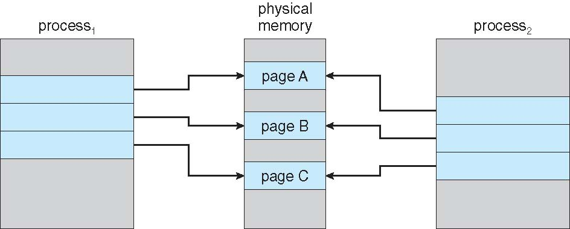
Before Process 1 Modifies Page C

Slide 94
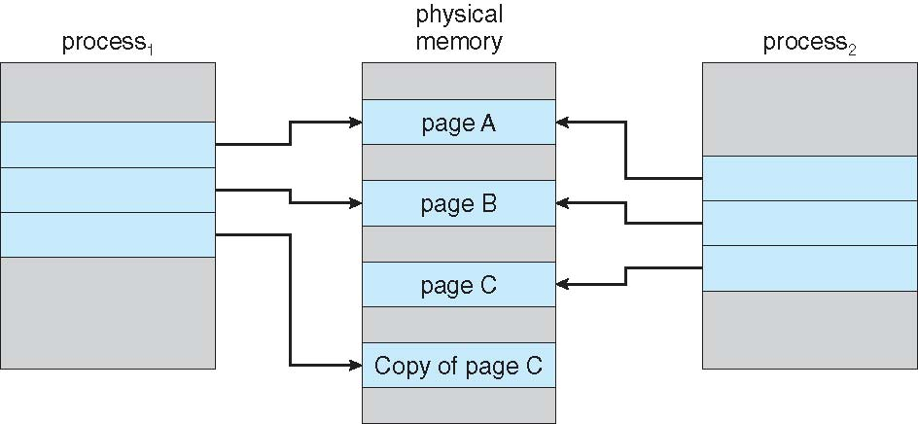
After Process 1 Modifies Page C

Slide 95
What Happens if There is no Free Frame?
Used up by process pages
Also in demand from the kernel, I/O buffers, etc
How much to allocate to each?
Page replacement – find some page in memory, but not really in use, page it out
Algorithm – terminate? swap out? replace the page?
Performance – want an algorithm which will result in minimum number of page faults
Same page may be brought into memory several times

Slide 96
Page Replacement
Prevent over-allocation of memory by modifying page-fault service routine to include page replacement
Use modify (dirty) bit to reduce overhead of page transfers – only modified pages are written to disk
Page replacement completes separation between logical memory and physical memory – large virtual memory can be provided on a smaller physical memory

Slide 97
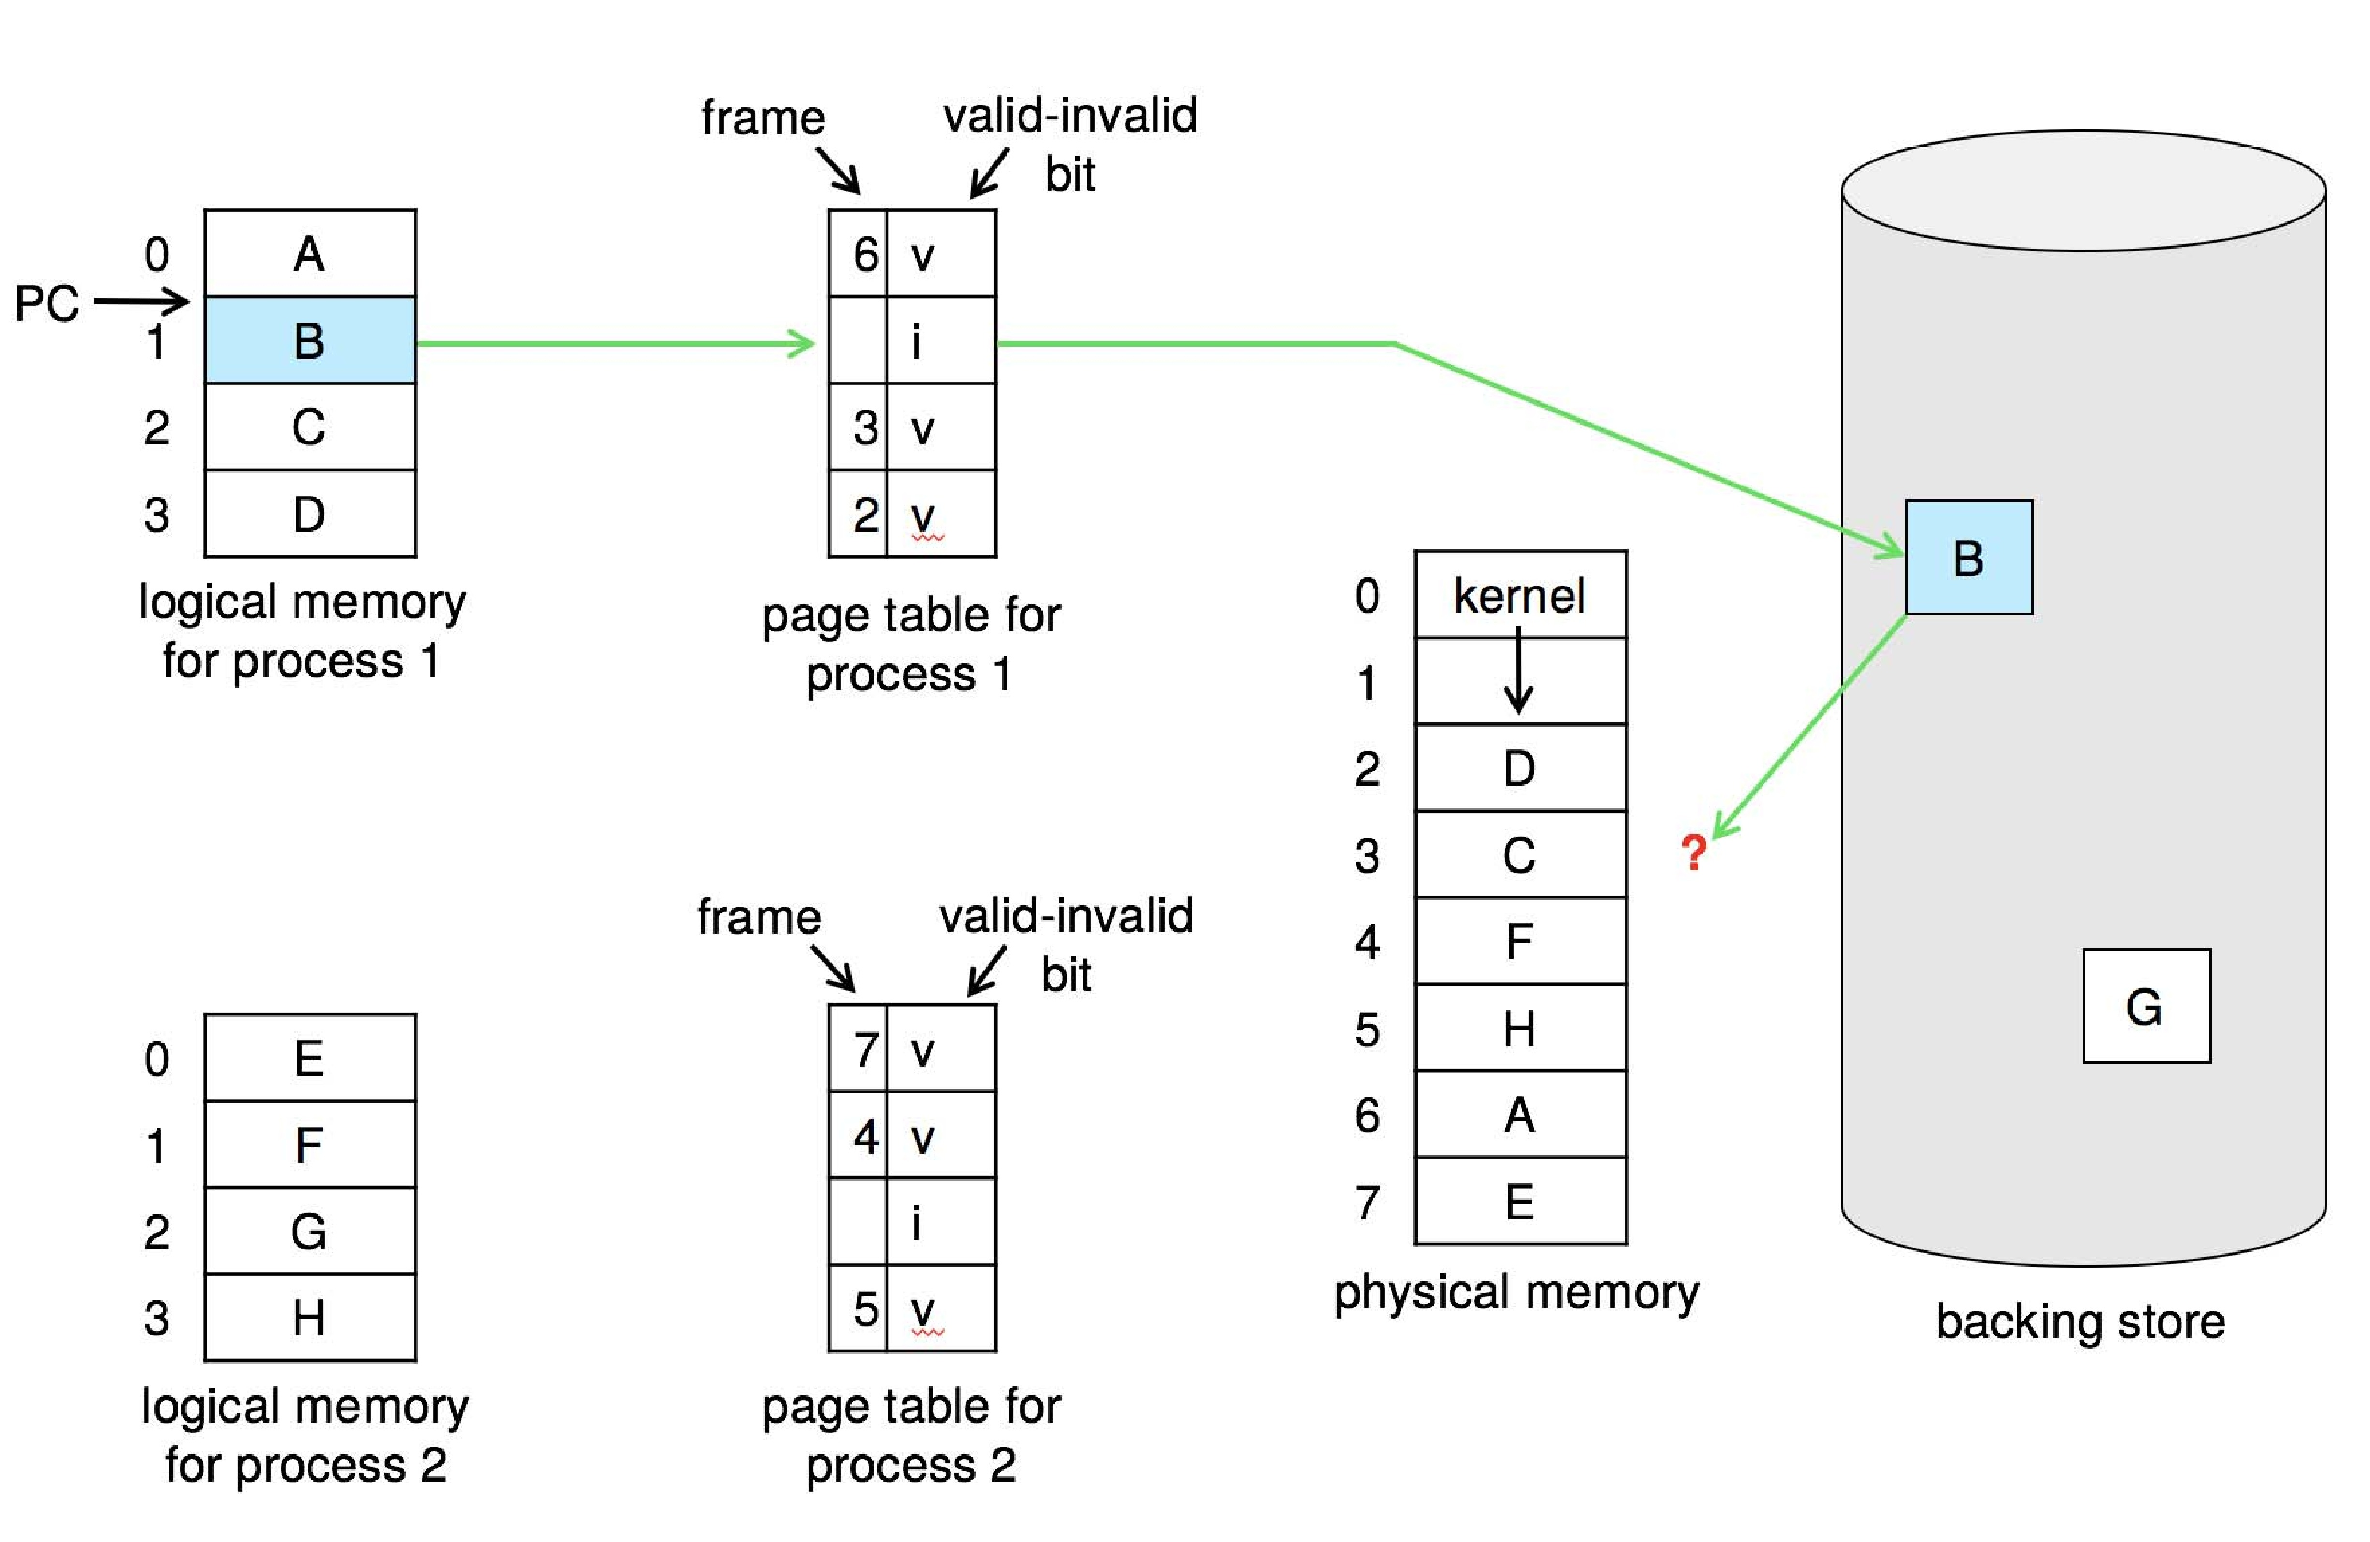
Need For Page Replacement

Slide 98
Basic Page Replacement
Find the location of the desired page on disk
Find a free frame: - If there is a free frame, use it - If there is no free frame, use a page replacement algorithm to select a victim frame - Write victim frame to disk if dirty
Bring the desired page into the (newly) free frame; update the page and frame tables
Continue the process by restarting the instruction that caused the trap
Note now potentially 2 page transfers for page fault – increasing EAT

Slide 99
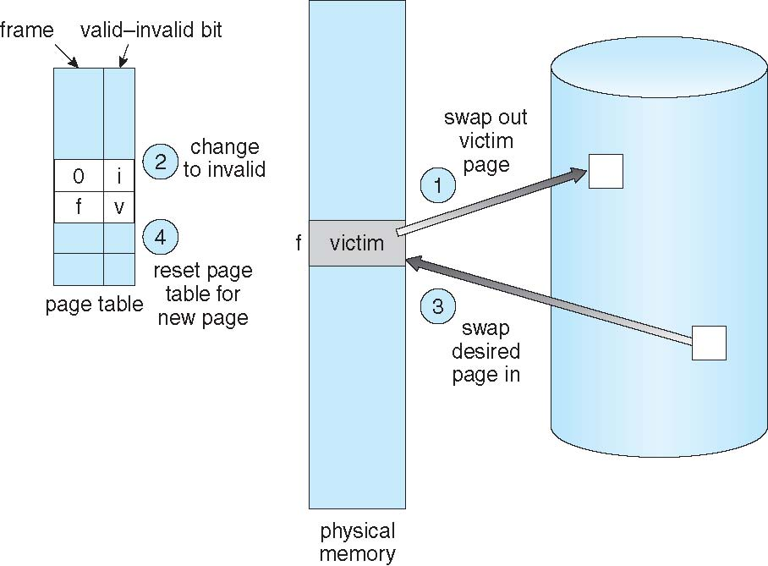
Page Replacement

Slide 100
Page and Frame Replacement Algorithms
Frame-allocation algorithm determines
How many frames to give each process
Which frames to replace
Page-replacement algorithm
Want lowest page-fault rate on both first access and re-access
Evaluate algorithm by running it on a particular string of memory references (reference string) and computing the number of page faults on that string
String is just page numbers, not full addresses
Repeated access to the same page does not cause a page fault
Results depend on number of frames available
In all our examples, the reference string of referenced page numbers is
7,0,1,2,0,3,0,4,2,3,0,3,0,3,2,1,2,0,1,7,0,1

Slide 101
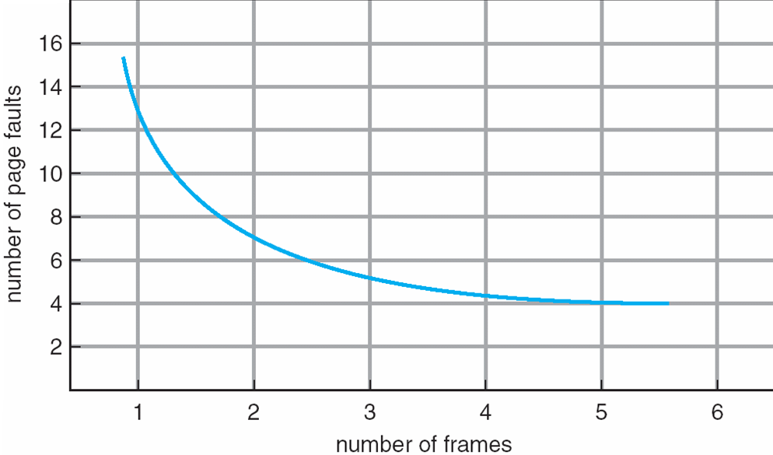
Graph of Page Faults Versus the Number of Frames

Slide 102
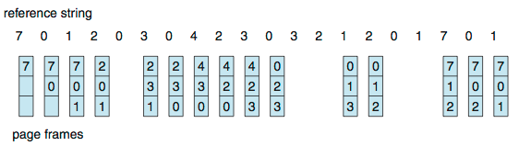
First-In-First-Out (FIFO) Algorithm
Reference string: 7,0,1,2,0,3,0,4,2,3,0,3,0,3,2,1,2,0,1,7,0,1
3 frames (3 pages can be in memory at a time per process)
Can vary by reference string: consider 1,2,3,4,1,2,5,1,2,3,4,5
Adding more frames can cause more page faults!
Belady’s Anomaly
How to track ages of pages?
Just use a FIFO queue
15 page faults

Slide 103
FIFO Illustrating Belady’s Anomaly

Slide 104
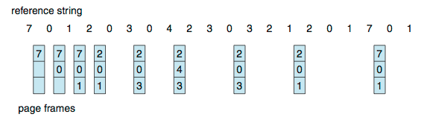
Optimal Algorithm
Replace page that will not be used for longest period of time
9 is optimal for the example
How do you know this?
Can’t read the future
Used for measuring how well your algorithm performs

Slide 105
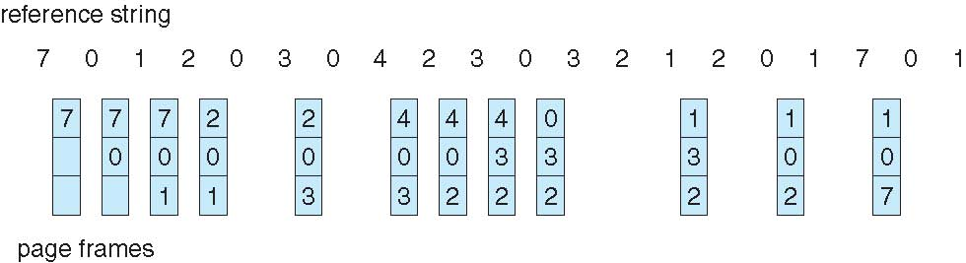
Least Recently Used (LRU) Algorithm
Use past knowledge rather than future
Replace page that has not been used in the most amount of time
Associate time of last use with each page
12 faults – better than FIFO but worse than OPT
Generally good algorithm and frequently used
But how to implement?

Slide 106
LRU Algorithm (Cont.)
Counter implementation
Every page entry has a counter; every time page is referenced through this entry, copy the clock into the counter
When a page needs to be changed, look at the counters to find smallest value
Search through table needed
Stack implementation
Keep a stack of page numbers in a double link form:
Page referenced:
move it to the top
requires 6 pointers to be changed
But each update more expensive
No search for replacement

Slide 107
LRU Algorithm (Cont.)
LRU and OPT are cases of stack algorithms that don’t have Belady’s Anomaly
Use Of A Stack to Record Most Recent Page References

Slide 108
LRU Approximation Algorithms
LRU needs special hardware and still slow
Reference bit
With each page associate a bit, initially = 0
When page is referenced bit set to 1
Replace any with reference bit = 0 (if one exists)
We do not know the order, however

Slide 109
LRU Approximation Algorithms (cont.)
Second-chance algorithm
Generally FIFO, plus hardware-provided reference bit
Clock replacement
If page to be replaced has
Reference bit = 0 -> replace it
reference bit = 1 then:
set reference bit 0, leave page in memory
replace next page, subject to same rules

Slide 110
Second-chance Algorithm

Slide 111
Enhanced Second-Chance Algorithm
Improve algorithm by using reference bit and modify bit (if available) in concert
Take ordered pair (reference, modify):
(0, 0) neither recently used not modified – best page to replace
(0, 1) not recently used but modified – not quite as good, must write out before replacement
(1, 0) recently used but clean – probably will be used again soon
(1, 1) recently used and modified – probably will be used again soon and need to write out before replacement
When page replacement called for, use the clock scheme but use the four classes replace page in lowest non-empty class
Might need to search circular queue several times

Slide 112
Counting Algorithms
Keep a counter of the number of references that have been made to each page
Not common
Least Frequently Used (LFU) Algorithm:
Replaces page with smallest count
Most Frequently Used (MFU) Algorithm:
Based on the argument that the page with the smallest count was probably just brought in and has yet to be used

Slide 113
Page-Buffering Algorithms
Keep a pool of free frames, always
Then frame available when needed, not found at fault time
Read page into free frame and select victim to evict and add to free pool
When convenient, evict victim
Possibly, keep list of modified pages
When backing store otherwise idle, write pages there and set to non-dirty
Possibly, keep free frame contents intact and note what is in them
If referenced again before reused, no need to load contents again from disk
Generally useful to reduce penalty if wrong victim frame selected

Slide 114
Applications and Page Replacement
All of these algorithms have OS guessing about future page access
Some applications have better knowledge – i.e. databases
Memory intensive applications can cause double buffering
OS keeps copy of page in memory as I/O buffer
Application keeps page in memory for its own work
Operating system can given direct access to the disk, getting out of the way of the applications
Raw disk mode
Bypasses buffering, locking, etc

Slide 115
Allocation of Frames
Each process needs minimum number of frames
Example: IBM 370 – 6 pages to handle SS MOVE instruction:
instruction is 6 bytes, might span 2 pages
2 pages to handle from
2 pages to handle to
Maximum of course is total frames in the system
Two major allocation schemes
fixed allocation
priority allocation
Many variations

Slide 116
Fixed Allocation
Equal allocation – For example, if there are 100 frames (after allocating frames for the OS) and 5 processes, give each process 20 frames
Keep some as free frame buffer pool
Proportional allocation – Allocate according to the size of process
Dynamic as degree of multiprogramming, process sizes change

Slide 117
Global vs. Local Allocation
Global replacement – process selects a replacement frame from the set of all frames; one process can take a frame from another
But then process execution time can vary greatly
But greater throughput so more common
Local replacement – each process selects from only its own set of allocated frames
More consistent per-process performance
But possibly underutilized memory

Slide 118
Reclaiming Pages
A strategy to implement global page-replacement policy
All memory requests are satisfied from the free-frame list, rather than waiting for the list to drop to zero before we begin selecting pages for replacement,
Page replacement is triggered when the list falls below a certain threshold.
This strategy attempts to ensure there is always sufficient free memory to satisfy new requests.

Slide 119
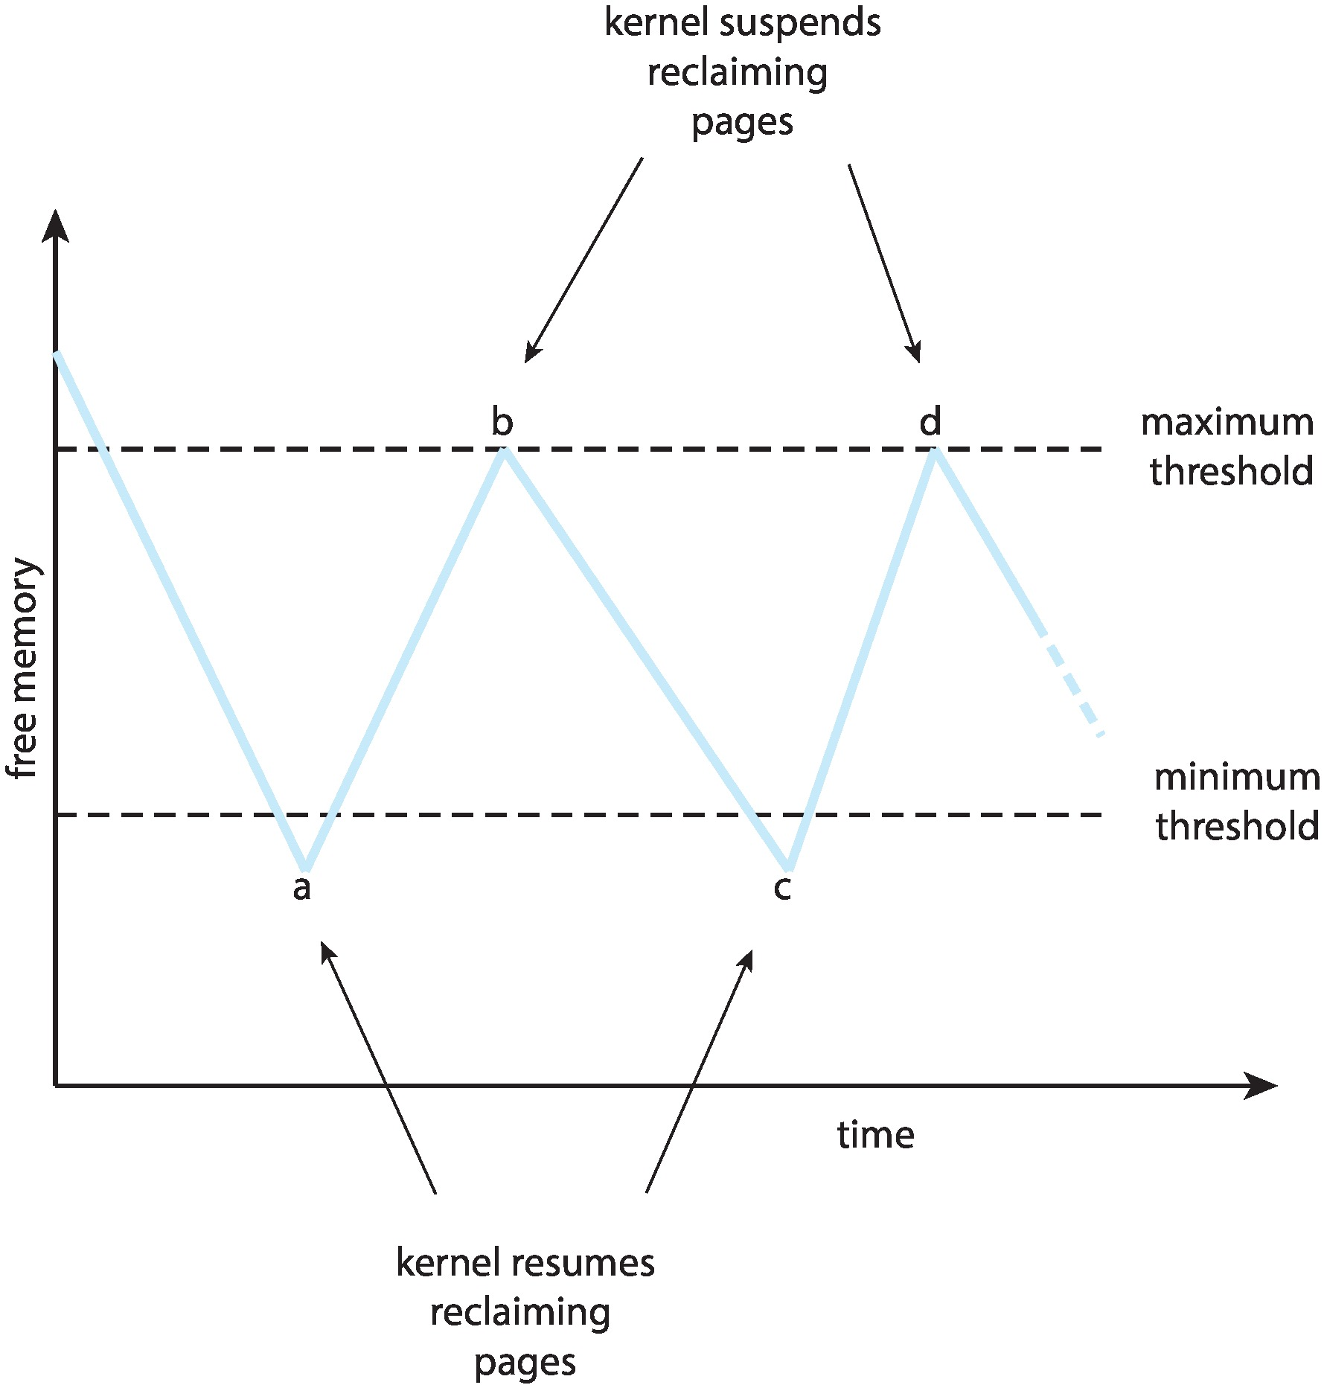
Reclaiming Pages Example

Slide 120
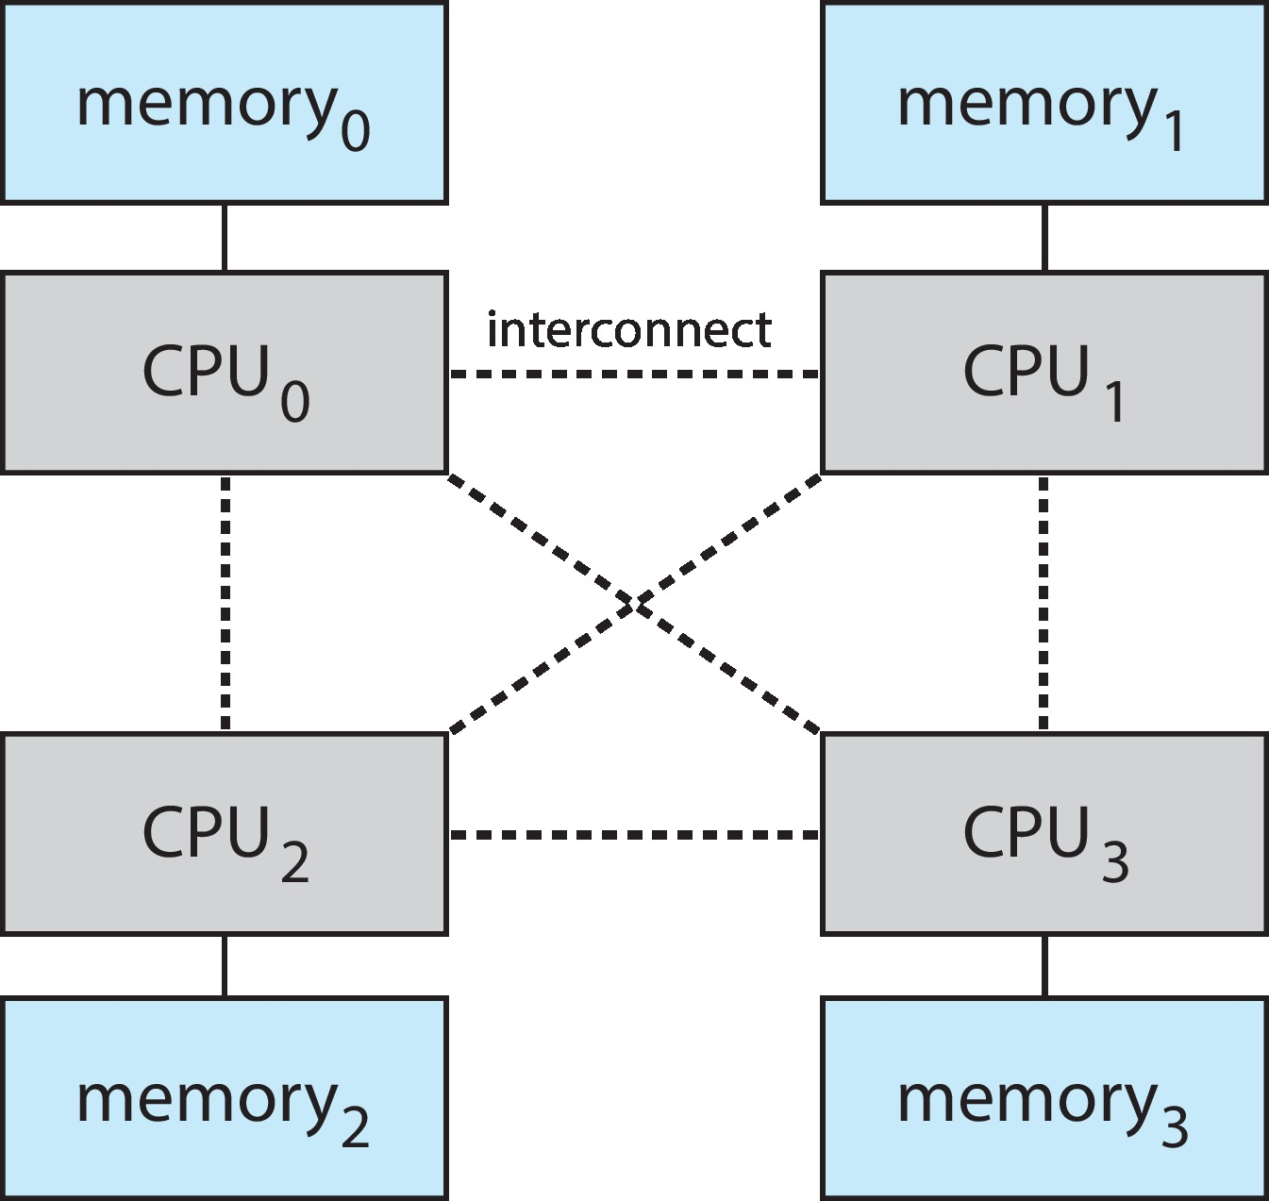
Non-Uniform Memory Access
So far, we assumed that all memory accessed equally
Many systems are NUMA – speed of access to memory varies
Consider system boards containing CPUs and memory, interconnected over a system bus
NUMA multiprocessing architecture

Slide 121
Non-Uniform Memory Access (Cont.)
Optimal performance comes from allocating memory “close to” the CPU on which the thread is scheduled
And modifying the scheduler to schedule the thread on the same system board when possible
Solved by Solaris by creating lgroups
Structure to track CPU / Memory low latency groups
Used my schedule and pager
When possible schedule all threads of a process and allocate all memory for that process within the lgroup

Slide 122
Thrashing
If a process does not have “enough” pages, the page-fault rate is very high
Page fault to get page
Replace existing frame
But quickly need replaced frame back
This leads to:
Low CPU utilization
Operating system thinking that it needs to increase the degree of multiprogramming
Another process added to the system

Slide 123
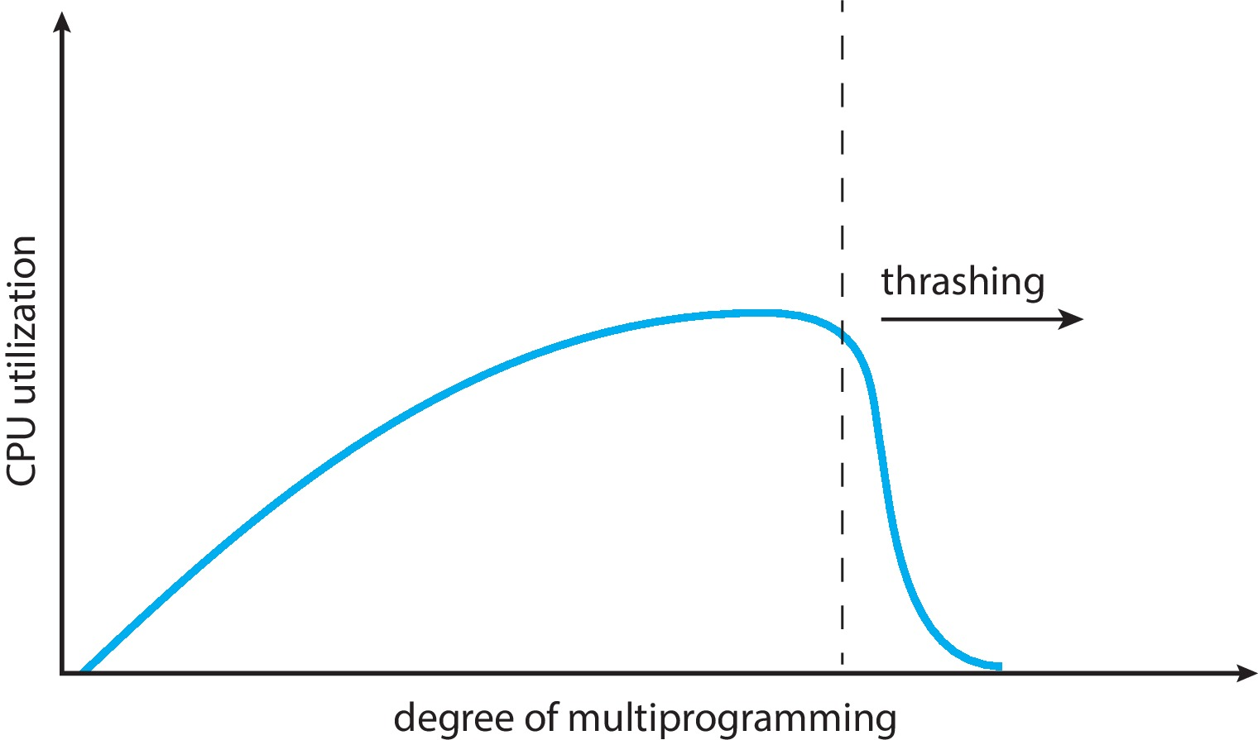
Thrashing (Cont.)
Thrashing. A process is busy swapping pages in and out

Slide 124
Demand Paging and Thrashing
Why does demand paging work?
Locality model
Process migrates from one locality to another
Localities may overlap
Why does thrashing occur?
Σ size of locality > total memory size
Limit effects by using local or priority page replacement

Slide 125
Locality In A Memory-Reference Pattern

Slide 126
Working-Set Model
Δ ≡ working-set window ≡ a fixed number of page references Example: 10,000 instructions
WSS_{i} (working set of Process P_{i}) = total number of pages referenced in the most recent Δ (varies in time)
if Δ too small will not encompass entire locality
if Δ too large will encompass several localities
if Δ = ∞ ⇒ will encompass entire program
D = Σ WSS_{i} ≡ total demand frames
Approximation of locality

Slide 127
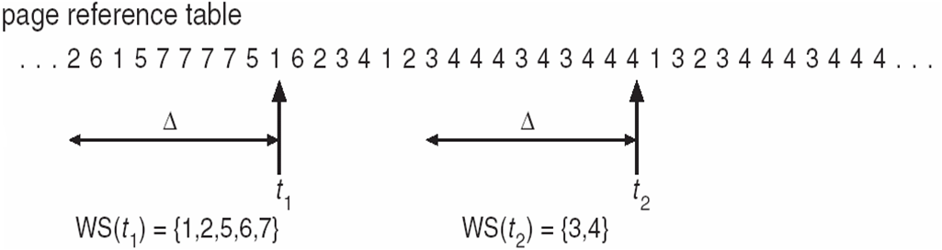
Working-Set Model (Cont.)
if D > m ⇒ Thrashing
Policy if D > m, then suspend or swap out one of the processes

Slide 128
Keeping Track of the Working Set
Approximate with interval timer + a reference bit
Example: Δ = 10,000
Timer interrupts after every 5000 time units
Keep in memory 2 bits for each page
Whenever a timer interrupts copy and sets the values of all reference bits to 0
If one of the bits in memory = 1 ⇒ page in working set
Why is this not completely accurate?
Improvement = 10 bits and interrupt every 1000 time units

Slide 129
Page-Fault Frequency
More direct approach than WSS
Establish “acceptable” page-fault frequency (PFF) rate and use local replacement policy
If actual rate too low, process loses frame
If actual rate too high, process gains frame

Slide 130
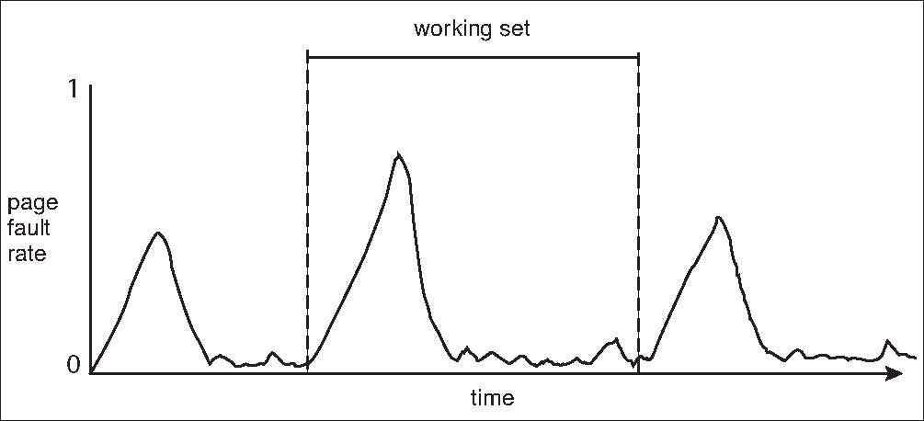
Working Sets and Page Fault Rates
Direct relationship between working set of a process and its page-fault rate
Working set changes over time
Peaks and valleys over time

Slide 131
Allocating Kernel Memory
Treated differently from user memory
Often allocated from a free-memory pool
Kernel requests memory for structures of varying sizes
Some kernel memory needs to be contiguous
i.e., for device I/O

Slide 132
Buddy System
Allocates memory from fixed-size segment consisting of physically-contiguous pages
Memory allocated using power-of-2 allocator
Satisfies requests in units sized as power of 2
Request rounded up to next highest power of 2
When smaller allocation needed than is available, current chunk split into two buddies of next-lower power of 2
Continue until appropriate sized chunk available
For example, assume 256KB chunk available, kernel requests 21KB
Split into A_{L} _{and} A_{R} of 128KB each
One further divided into B_{L} and B_{R} of 64KB
One further into C_{L} and C_{R} of 32KB each – one used to satisfy request
Advantage – quickly coalesce unused chunks into larger chunk
Disadvantage - fragmentation

Slide 133
Buddy System Allocator

Slide 134
Slab Allocator
Alternate strategy
Slab is one or more physically contiguous pages
Cache consists of one or more slabs
Single cache for each unique kernel data structure
Each cache filled with objects – instantiations of the data structure
When cache created, filled with objects marked as free
When structures stored, objects marked as used
If slab is full of used objects, next object allocated from empty slab
If no empty slabs, new slab allocated
Benefits include no fragmentation, fast memory request satisfaction

Slide 135
Slab Allocation

Slide 136
Slab Allocator in Linux
For example process descriptor is of type struct task_struct
Approx 1.7KB of memory
New task -> allocate new struct from cache
Will use existing free struct task_struct
Slab can be in three possible states
Full – all used
Empty – all free
Partial – mix of free and used
Upon request, slab allocator
Uses free struct in partial slab
If none, takes one from empty slab
If no empty slab, create new empty

Slide 137
Slab Allocator in Linux (Cont.)
Slab started in Solaris, now wide-spread for both kernel mode and user memory in various OSes
Linux 2.2 had SLAB, now has both SLOB and SLUB allocators
SLOB for systems with limited memory
Simple List of Blocks – maintains 3 list objects for small, medium, large objects
SLUB is performance-optimized SLAB removes per-CPU queues, metadata stored in page structure

Slide 138
Other Considerations
Prepaging
Page size
TLB reach
Inverted page table
Program structure
I/O interlock and page locking

Slide 139
Prepaging
To reduce the large number of page faults that occurs at process startup
Prepage all or some of the pages a process will need, before they are referenced
But if prepaged pages are unused, I/O and memory was wasted
Assume s pages are prepaged and α of the pages is used
Is cost of s * α save pages faults > or < than the cost of prepaging s * (1- α) unnecessary pages?
α near zero ⇒ prepaging loses

Slide 140
Page Size
Sometimes OS designers have a choice
Especially if running on custom-built CPU
Page size selection must take into consideration:
Fragmentation
Page table size
Resolution
I/O overhead
Number of page faults
Locality
TLB size and effectiveness
Always power of 2, usually in the range 2¹² (4,096 bytes) to 2²² (4,194,304 bytes)
On average, growing over time

Slide 141
TLB Reach
TLB Reach - The amount of memory accessible from the TLB
TLB Reach = (TLB Size) X (Page Size)
Ideally, the working set of each process is stored in the TLB
Otherwise there is a high degree of page faults
Increase the Page Size
This may lead to an increase in fragmentation as not all applications require a large page size
Provide Multiple Page Sizes
This allows applications that require larger page sizes the opportunity to use them without an increase in fragmentation

Slide 142
Program Structure
Program structure
int[128,128] data;
Each row is stored in one page
Program 1
for (j = 0; j <128; j++) for (i = 0; i < 128; i++) data[i,j] = 0;
128 x 128 = 16,384 page faults
Program 2
for (i = 0; i < 128; i++) for (j = 0; j < 128; j++) data[i,j] = 0;
128 page faults

Slide 143
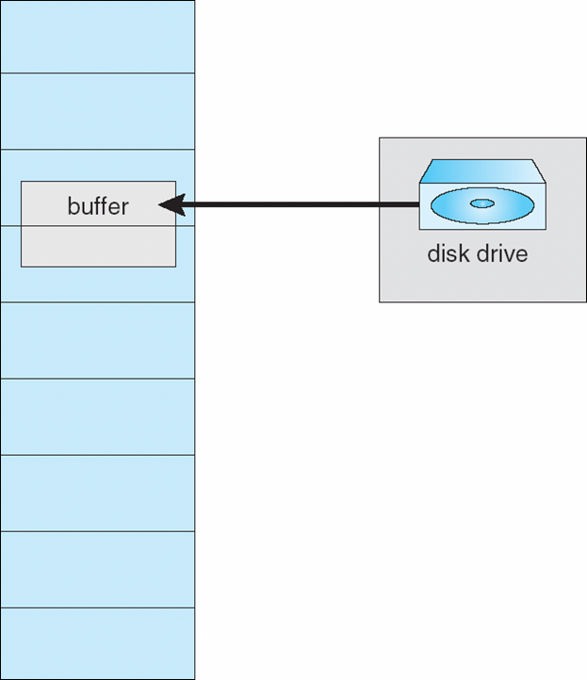
I/O interlock
I/O Interlock – Pages must sometimes be locked into memory
Consider I/O - Pages that are used for copying a file from a device must be locked from being selected for eviction by a page replacement algorithm
Pinning of pages to lock into memory

Slide 144
Operating System Examples
Windows
Solaris

Slide 145
Windows
Uses demand paging with clustering. Clustering brings in pages surrounding the faulting page
Processes are assigned working set minimum and working set maximum
Working set minimum is the minimum number of pages the process is guaranteed to have in memory
A process may be assigned as many pages up to its working set maximum
When the amount of free memory in the system falls below a threshold, automatic working set trimming is performed to restore the amount of free memory
Working set trimming removes pages from processes that have pages in excess of their working set minimum

Slide 146
Solaris
Maintains a list of free pages to assign faulting processes
Lotsfree – threshold parameter (amount of free memory) to begin paging
Desfree – threshold parameter to increasing paging
Minfree – threshold parameter to being swapping
Paging is performed by pageout process
Pageout scans pages using modified clock algorithm
Scanrate is the rate at which pages are scanned. This ranges from slowscan to fastscan
Pageout is called more frequently depending upon the amount of free memory available
Priority paging gives priority to process code pages

Slide 147
Solaris 2 Page Scanner

Slide 148
End of Chapter 10

Slide 149
Performance of Demand Paging
Stages in Demand Paging (worse case)
Trap to the operating system
Save the user registers and process state
Determine that the interrupt was a page fault
Check that the page reference was legal and determine the location of the page on the disk
Issue a read from the disk to a free frame:
Wait in a queue for this device until the read request is serviced
Wait for the device seek and/or latency time
Begin the transfer of the page to a free frame
While waiting, allocate the CPU to some other user
Receive an interrupt from the disk I/O subsystem (I/O completed)
Save the registers and process state for the other user
Determine that the interrupt was from the disk
Correct the page table and other tables to show page is now in memory
Wait for the CPU to be allocated to this process again
Restore the user registers, process state, and new page table, and then resume the interrupted instruction

Slide 150
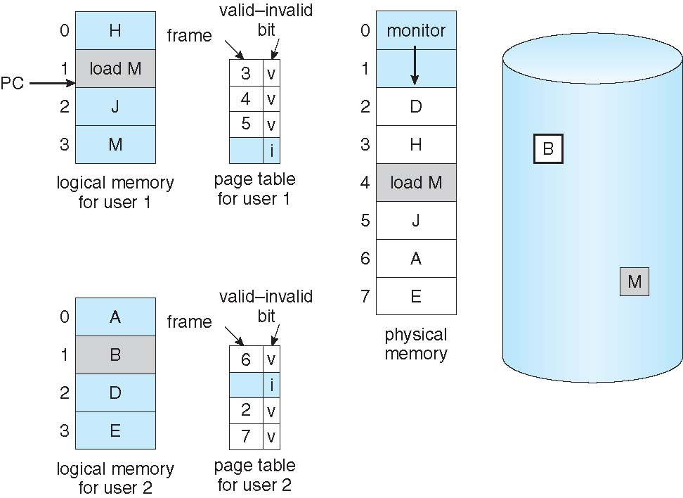
Need For Page Replacement

Slide 151
Priority Allocation
Use a proportional allocation scheme using priorities rather than size
If process P_{i} generates a page fault,
select for replacement one of its frames
select for replacement a frame from a process with lower priority number

Slide 152
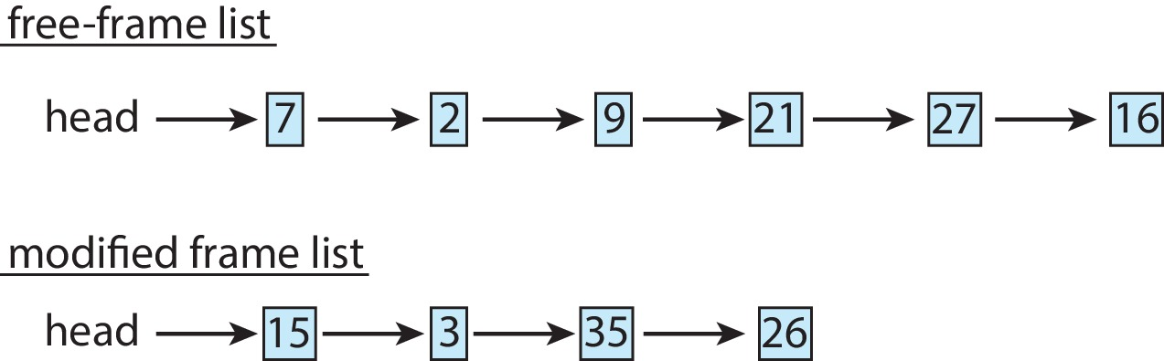
Memory Compression
Memory compression -- rather than paging out modified frames to swap space, we compress several frames into a single frame, enabling the system to reduce memory usage without resorting to swapping pages.
Consider the following free-frame-list consisting of 6 frames
Assume that this number of free frames falls below a certain threshold that triggers page replacement. The replacement algorithm (say, an LRU approximation algorithm) selects four frames -- 15, 3, 35, and 26 to place on the free-frame list. It first places these frames on a modified-frame list. Typically, the modified-frame list would next be written to swap space, making the frames available to the free-frame list. An alternative strategy is to compress a number of frames{\mdash}say, three{\mdash}and store their compressed versions n a single page frame.

Slide 153
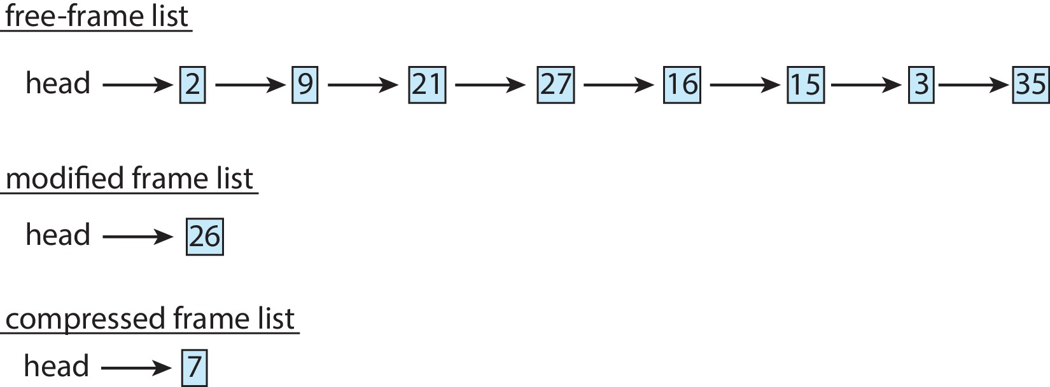
Memory Compression (Cont.)
An alternative to paging is memory compression.
Rather than paging out modified frames to swap space, we compress several frames into a single frame, enabling the system to reduce memory usage without resorting to swapping pages.

Slide 154
THANK YOU

